Slide 1
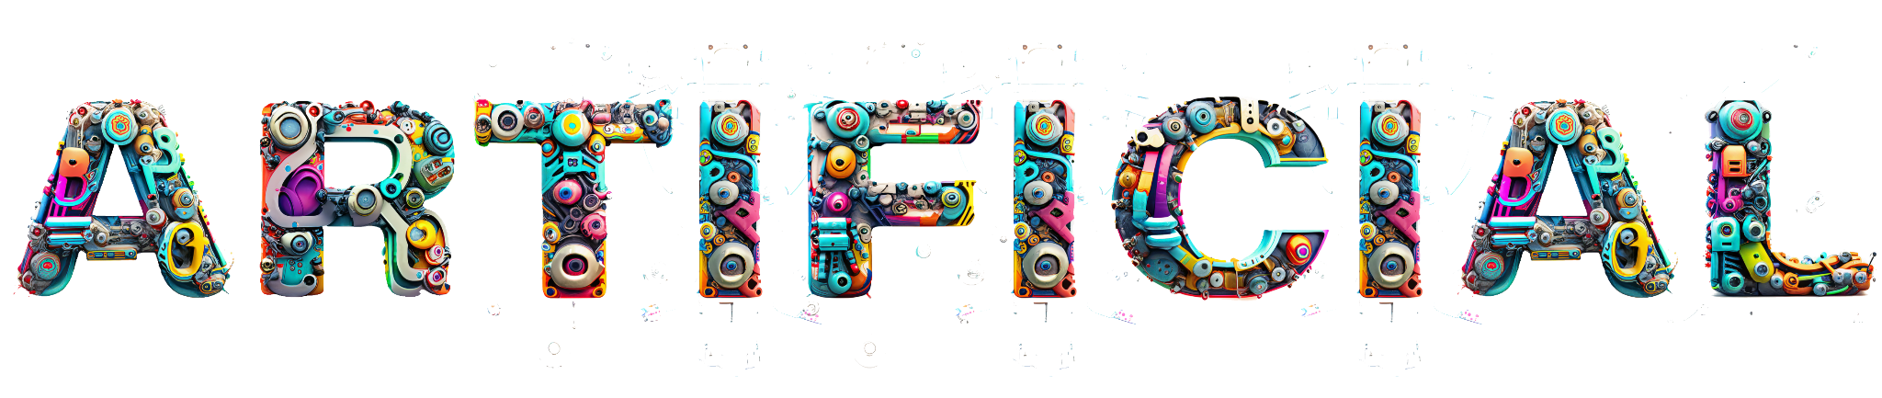
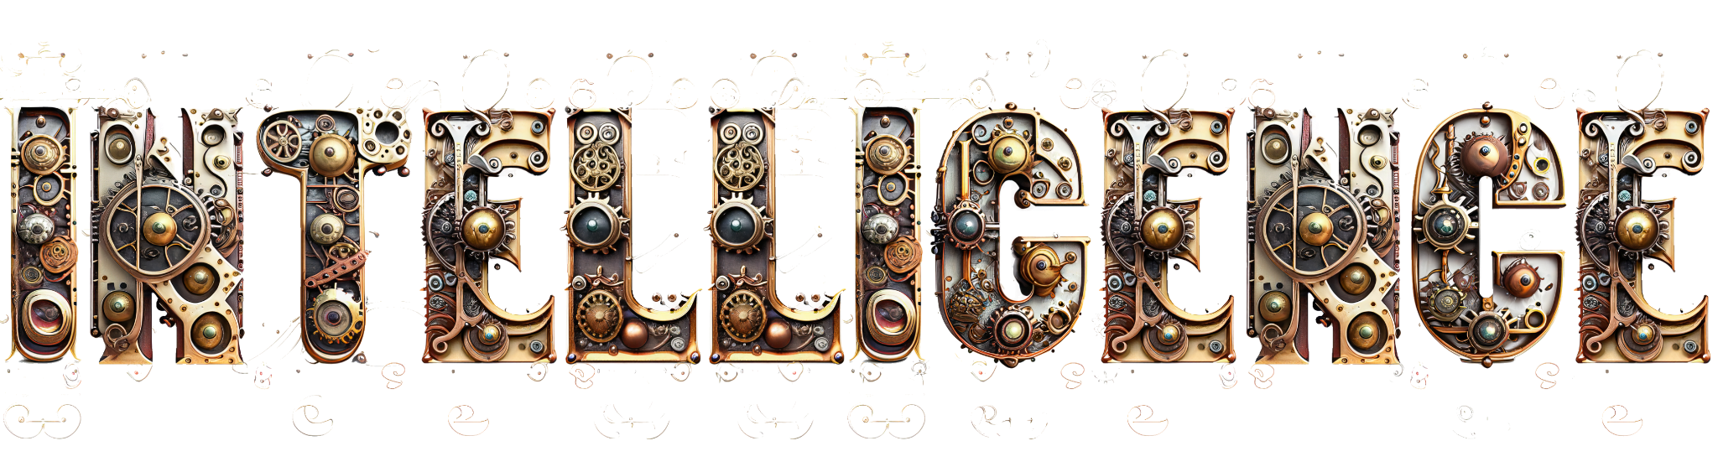


What is AI Art? Presented by Jeremiah Long

Slide 2
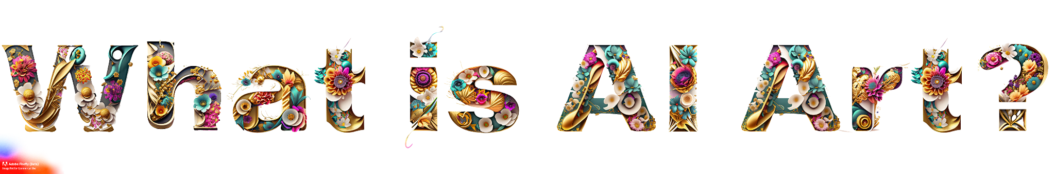
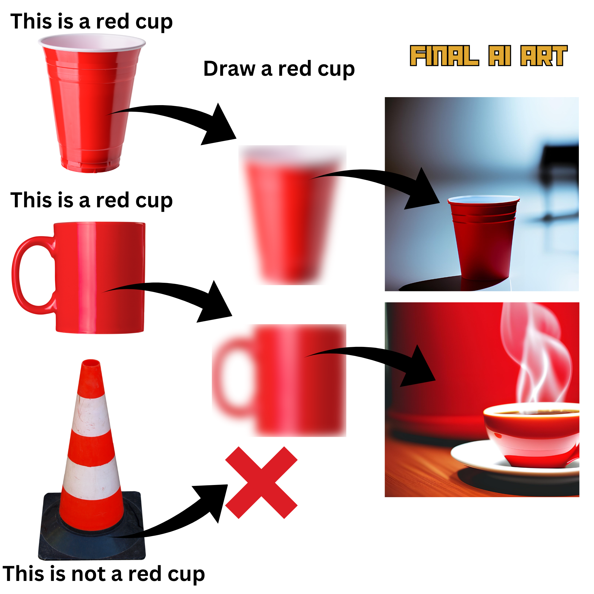
ELI5: A person trains a computer program, known as an AI model, to recognize patterns in images by providing it with lots of examples, like pictures of various objects, scenes, or artworks with captions.
The AI model, using special tools called transformers, learns to understand both the images and the text descriptions.
Over time, with enough training, the AI gets better at creating new images that match text descriptions. When you give it a prompt, it starts with a blurry picture and keeps improving it, adding details that match your words. If it's been shown many images of red cups with their descriptions, it can generate a new image of a red cup even if it's in a style or angle it hasn't seen before.

Slide 3
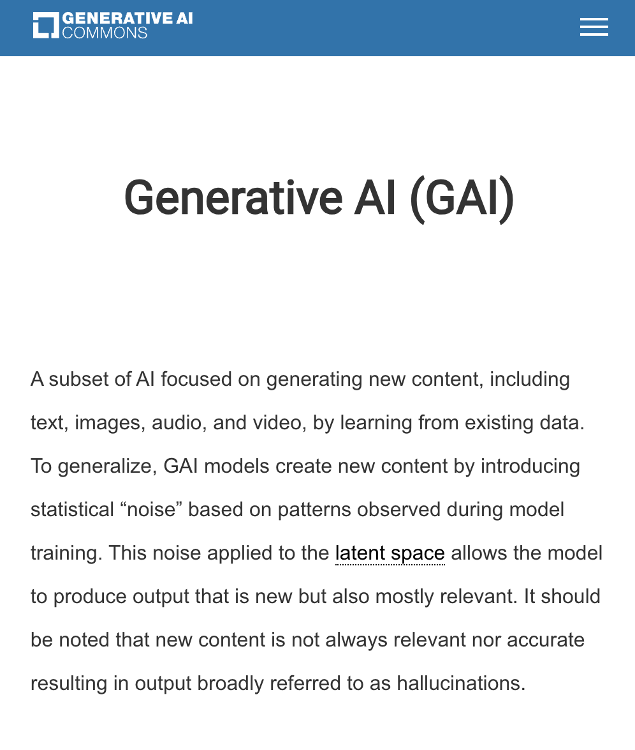
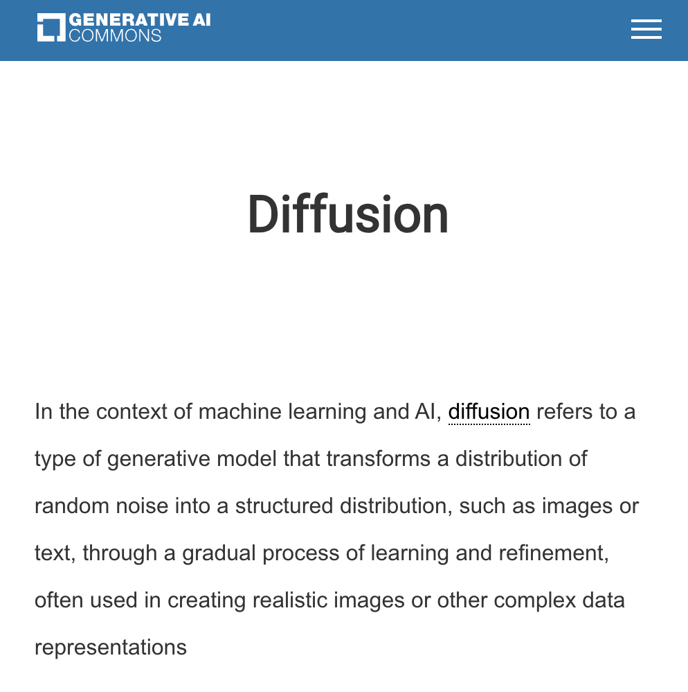
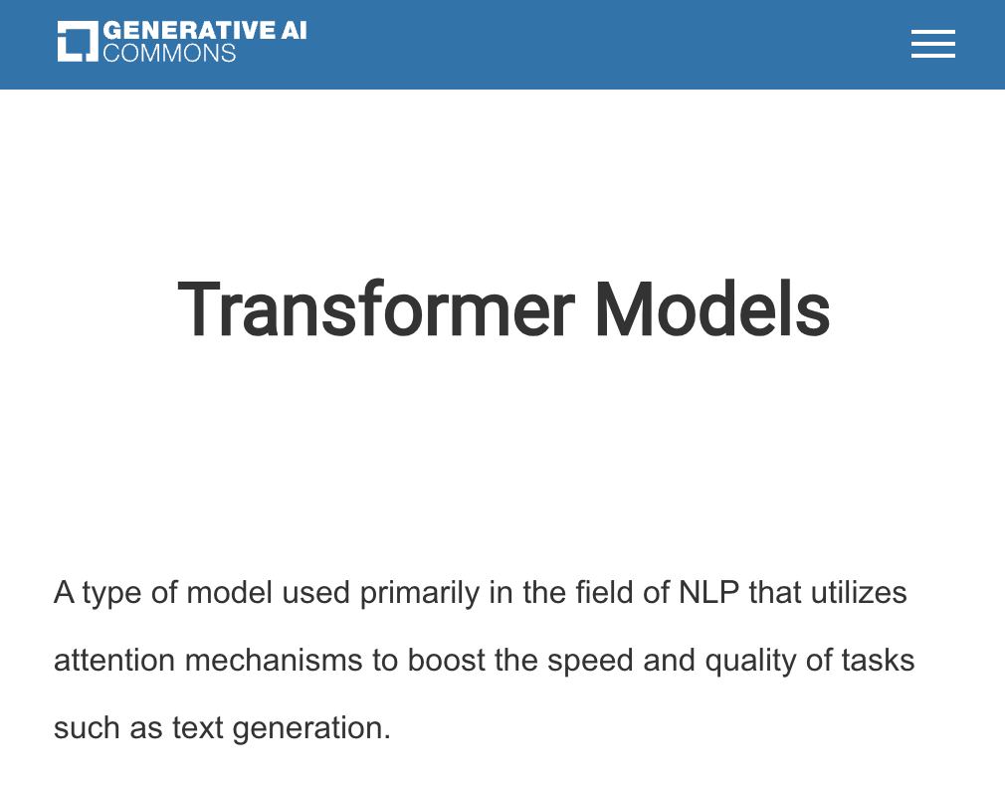
Useful technical definitions and glossary from Linux Foundation Generative AI Commons:
https://genaicommons.org/glossary

Slide 4
AI Art Tools for Image, Video, Audio
Adobe Firefly Suite (Firefly, Photoshop, Illustrator, Premier, etc)
Midjourney - Use through Discord or midjourney.com/app
DALL-E / Sora - OpenAI’s text-to-image/video models
Stable Diffusion - Mostly open source image, audio, video
Runway ML - Image, text-to-video, lipsync, editing, custom LoRA training
Meshy AI - text to 3D model tools for animation
Scenario AI - Game design assets, 3D models, custom LoRA training
Comfy UI - Highly technical image generation software, open source
Pika Labs - Advanced text-to-video models, camera control
Luma Labs - Gaussian Splat, volumetric capture, 3D, AI video
Many, many, others…

Slide 5
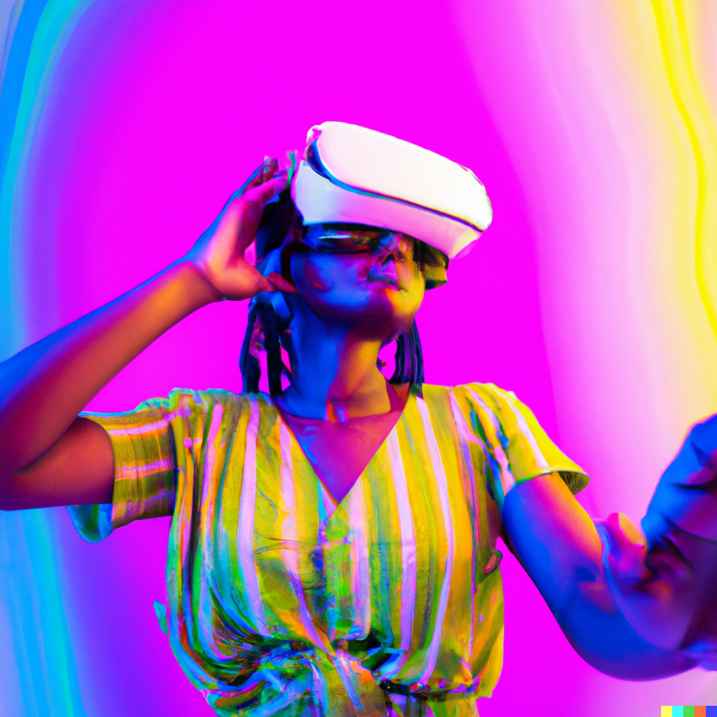

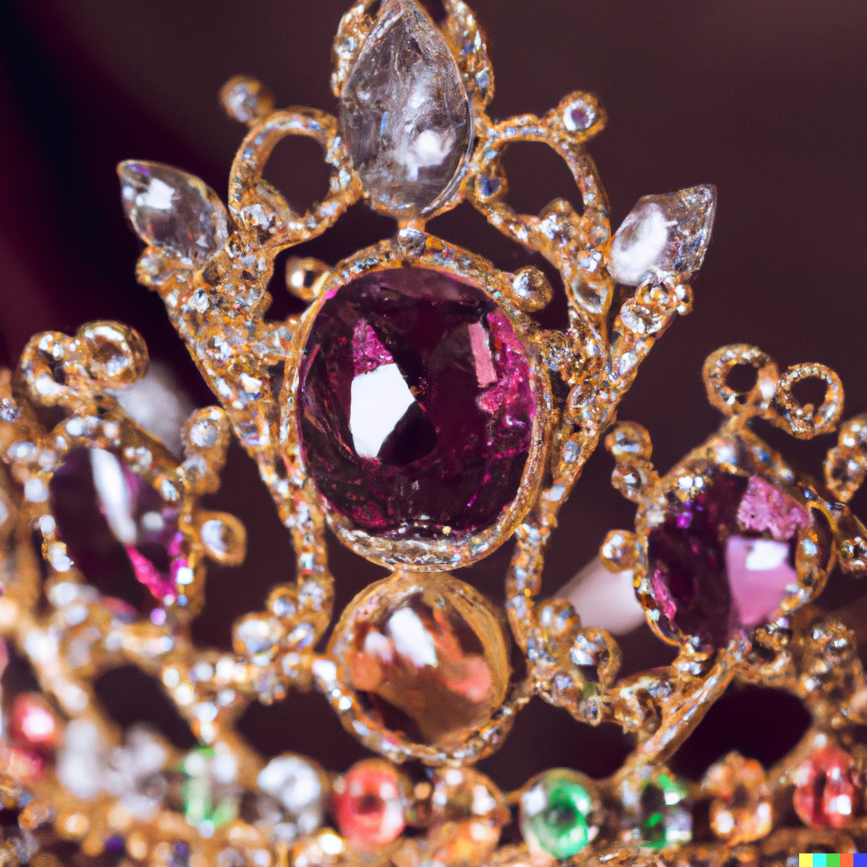
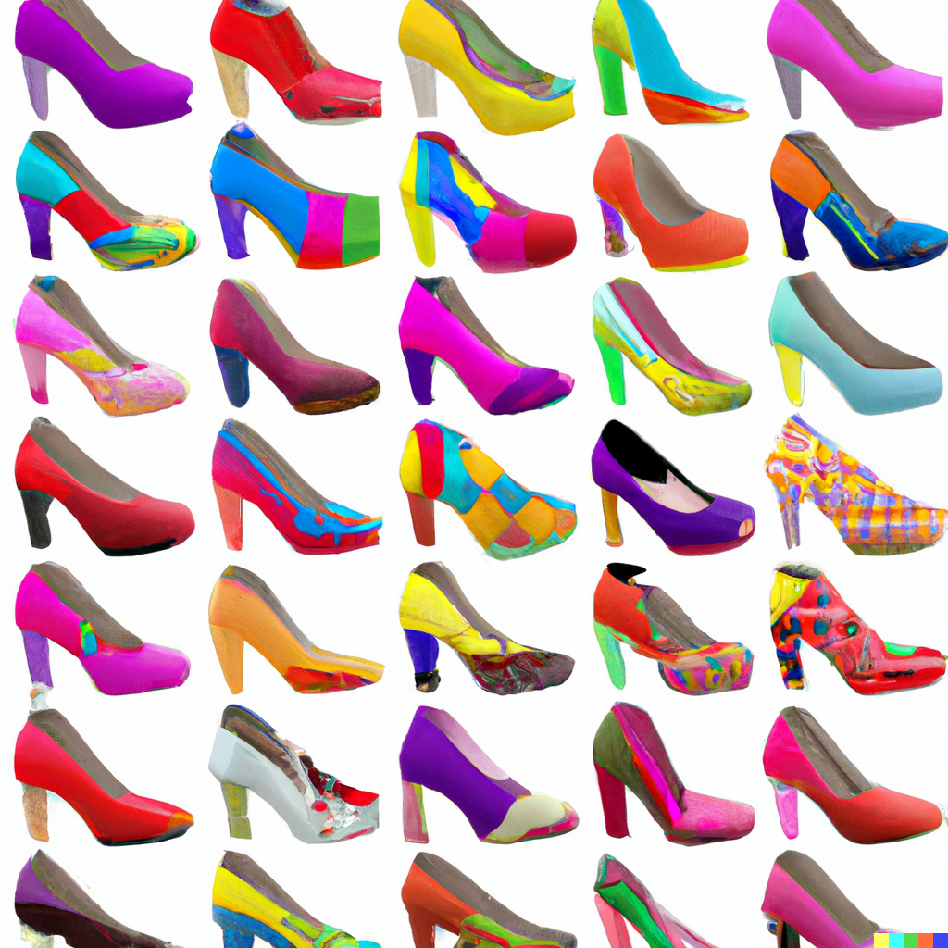
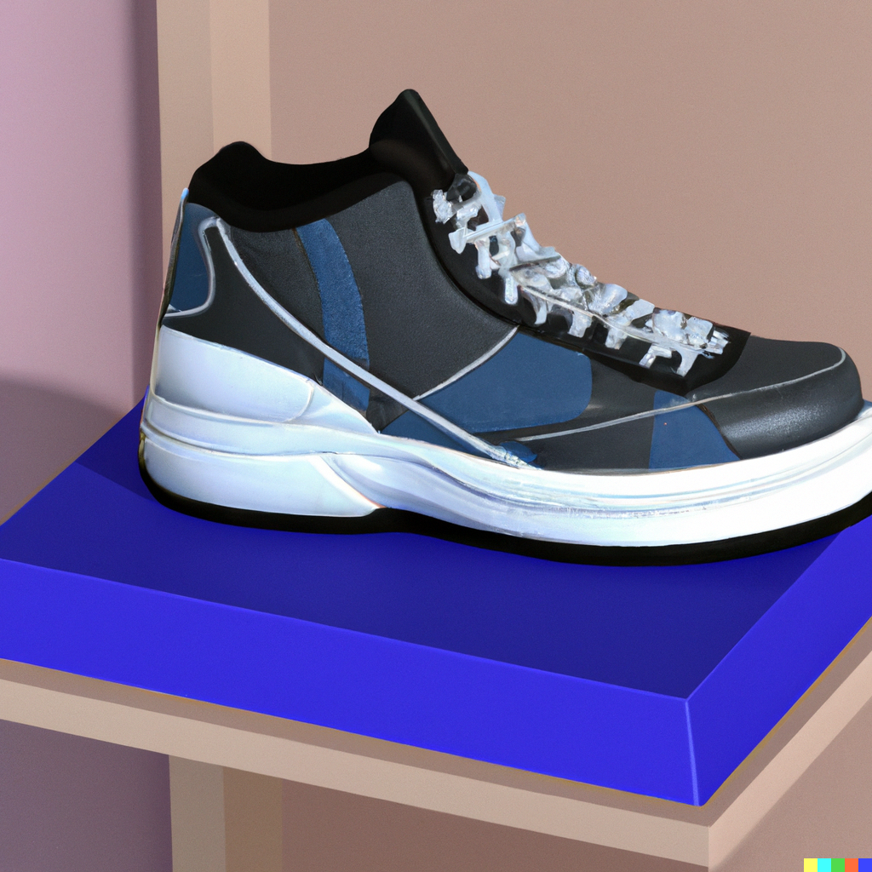
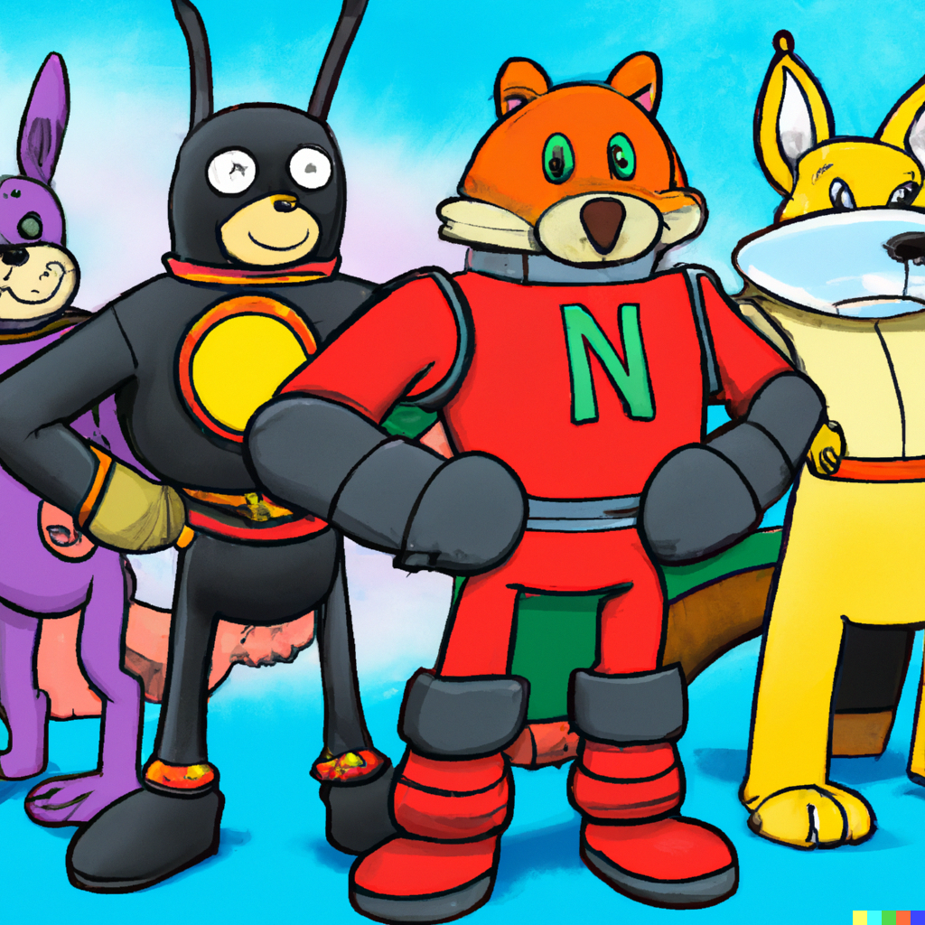
AI Art examples: What can you make?
Shoes
Clothing
Furniture
Characters
Art, Comics
Jewelry
Beverages
Album cover
Film and TV
Storytelling
Idea Exploration

Slide 6
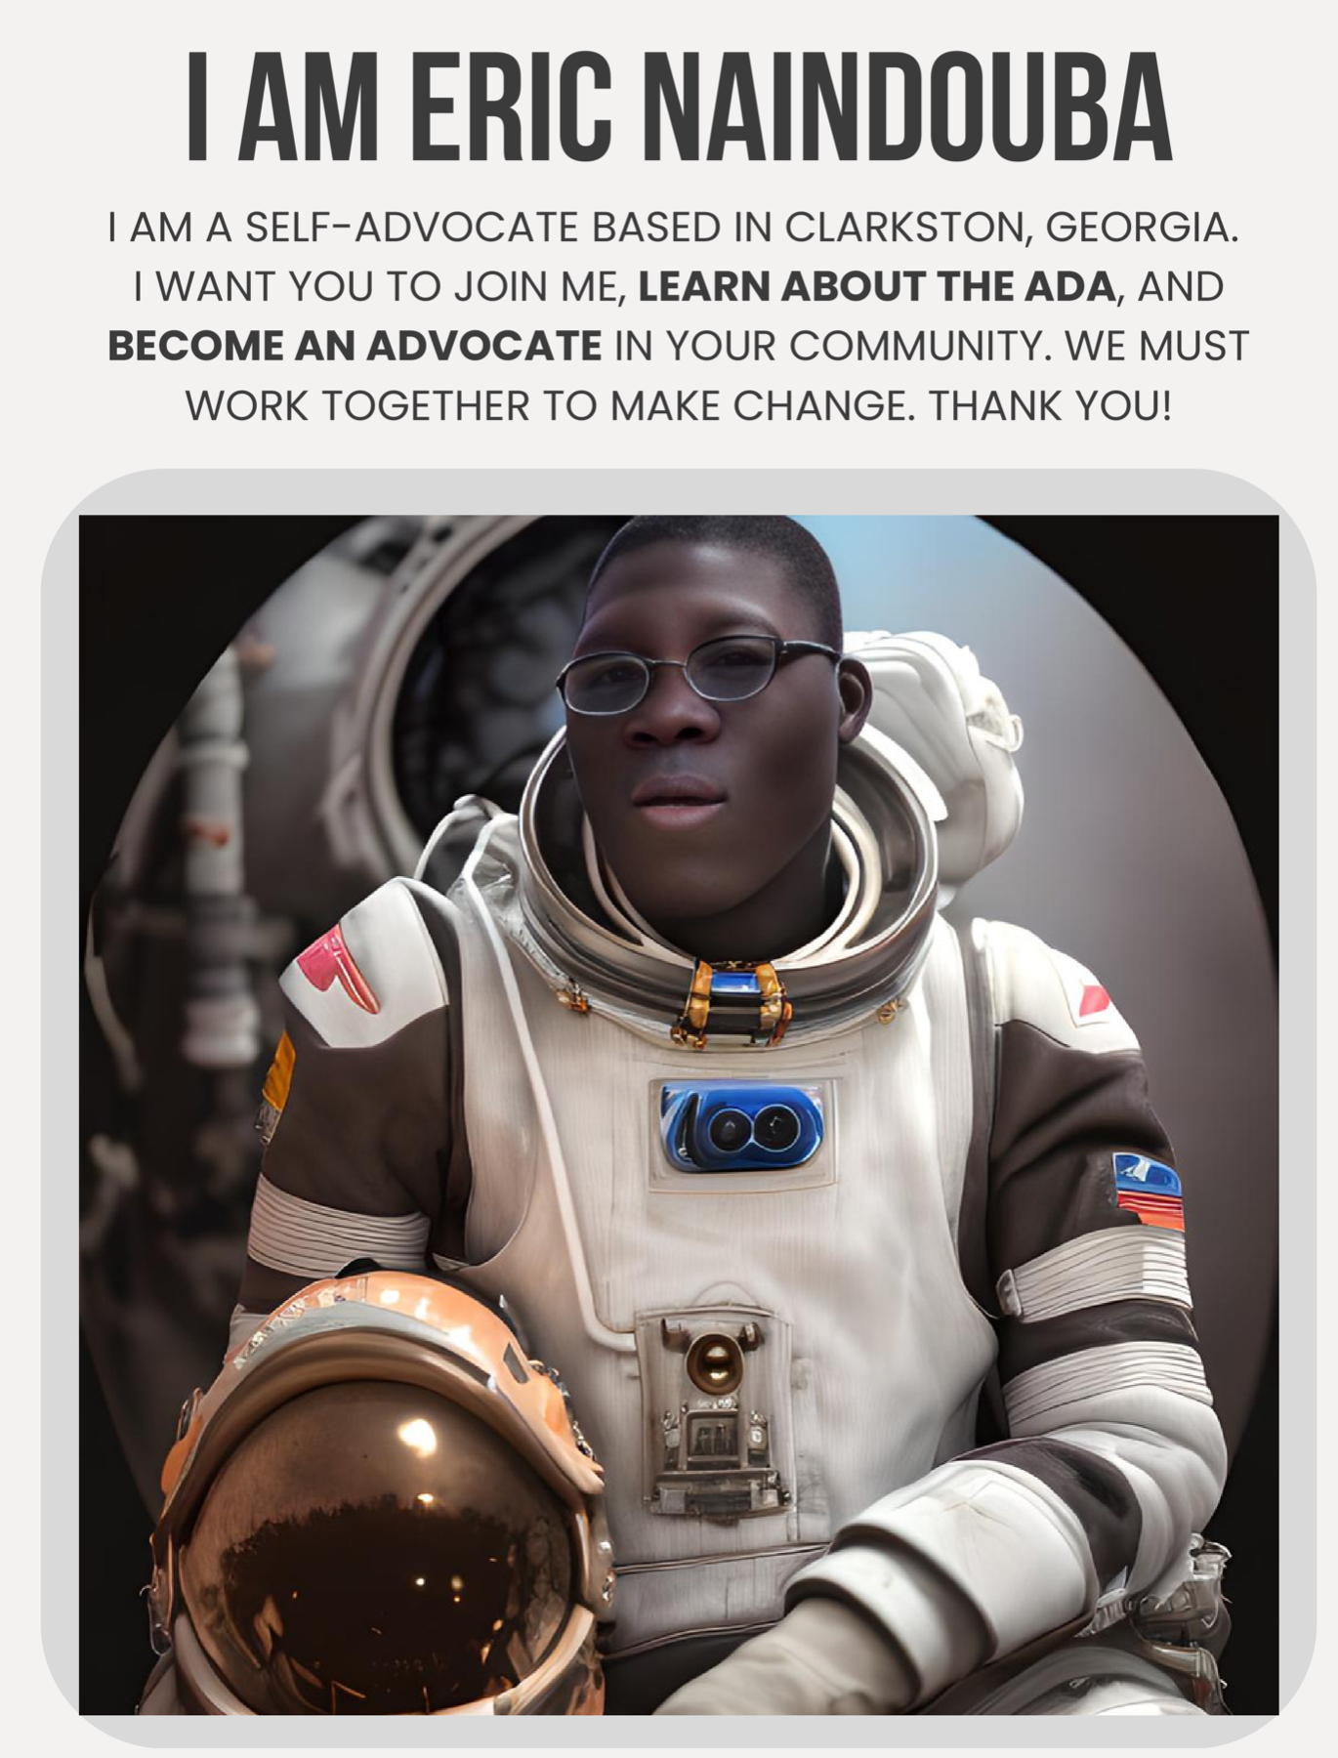
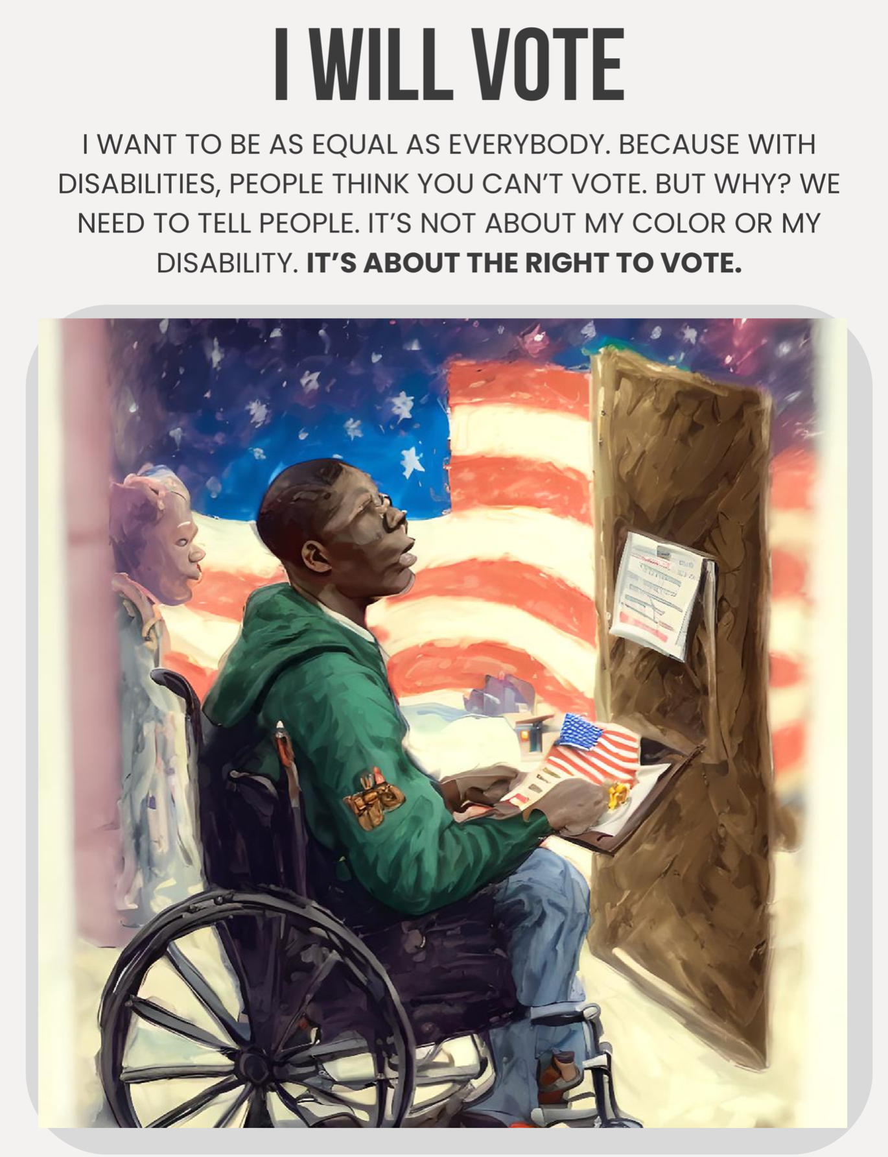
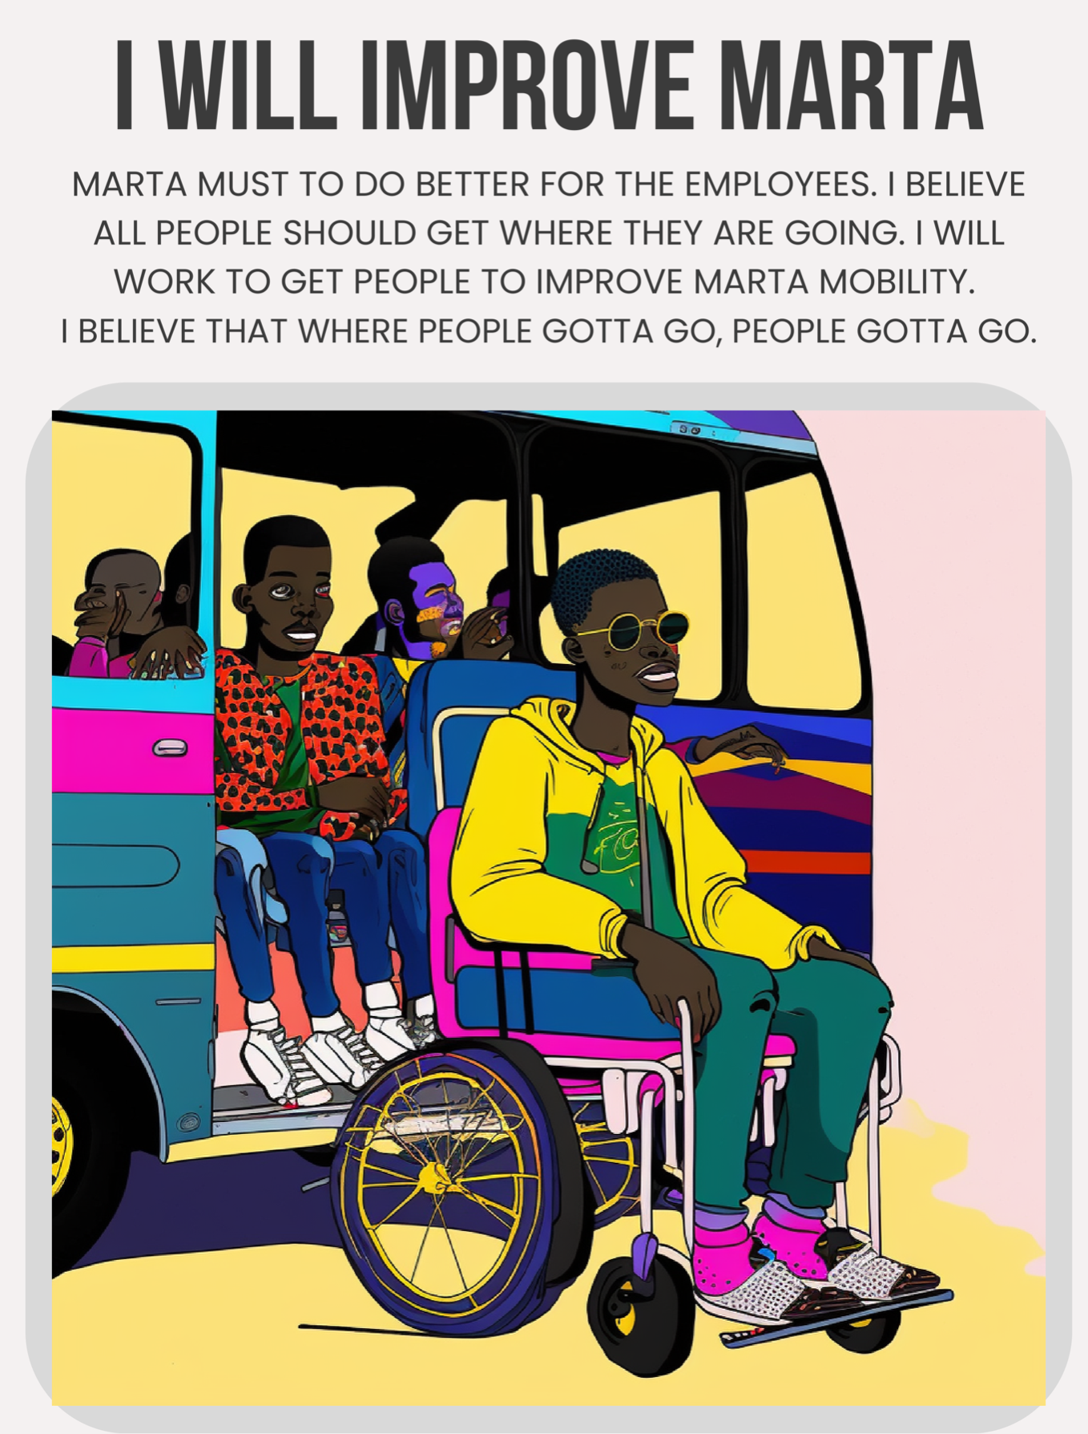

Slide 7
Ethics in AI and AI Art
AI might get the answer wrong, misunderstand what you want, or lack an understanding of your lived experience. It may produce inaccurate images
Training Data: Some AI companies train their model on copyrighted info and artworks. Some chose to only train on licensed sources.
Academic Honesty: If you use ChatGPT, or AI Art tools like Runway or Firefly. Just be honest about it!

Slide 8
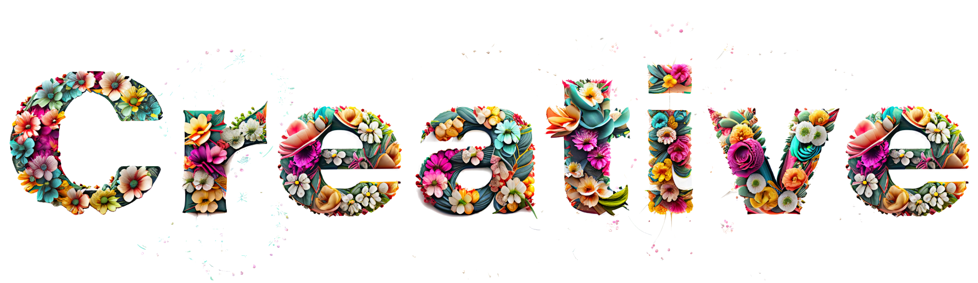
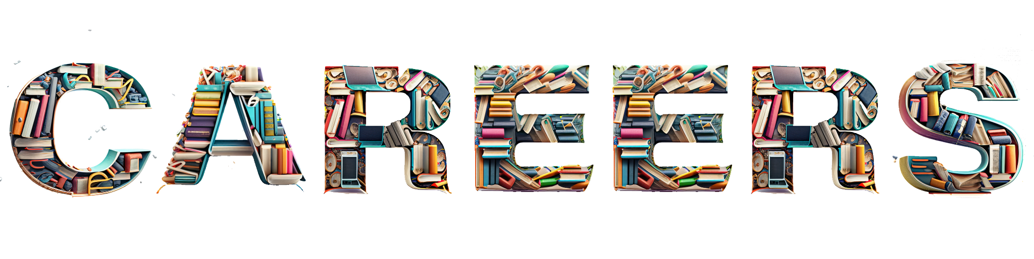
in

Slide 9
