Slide 1
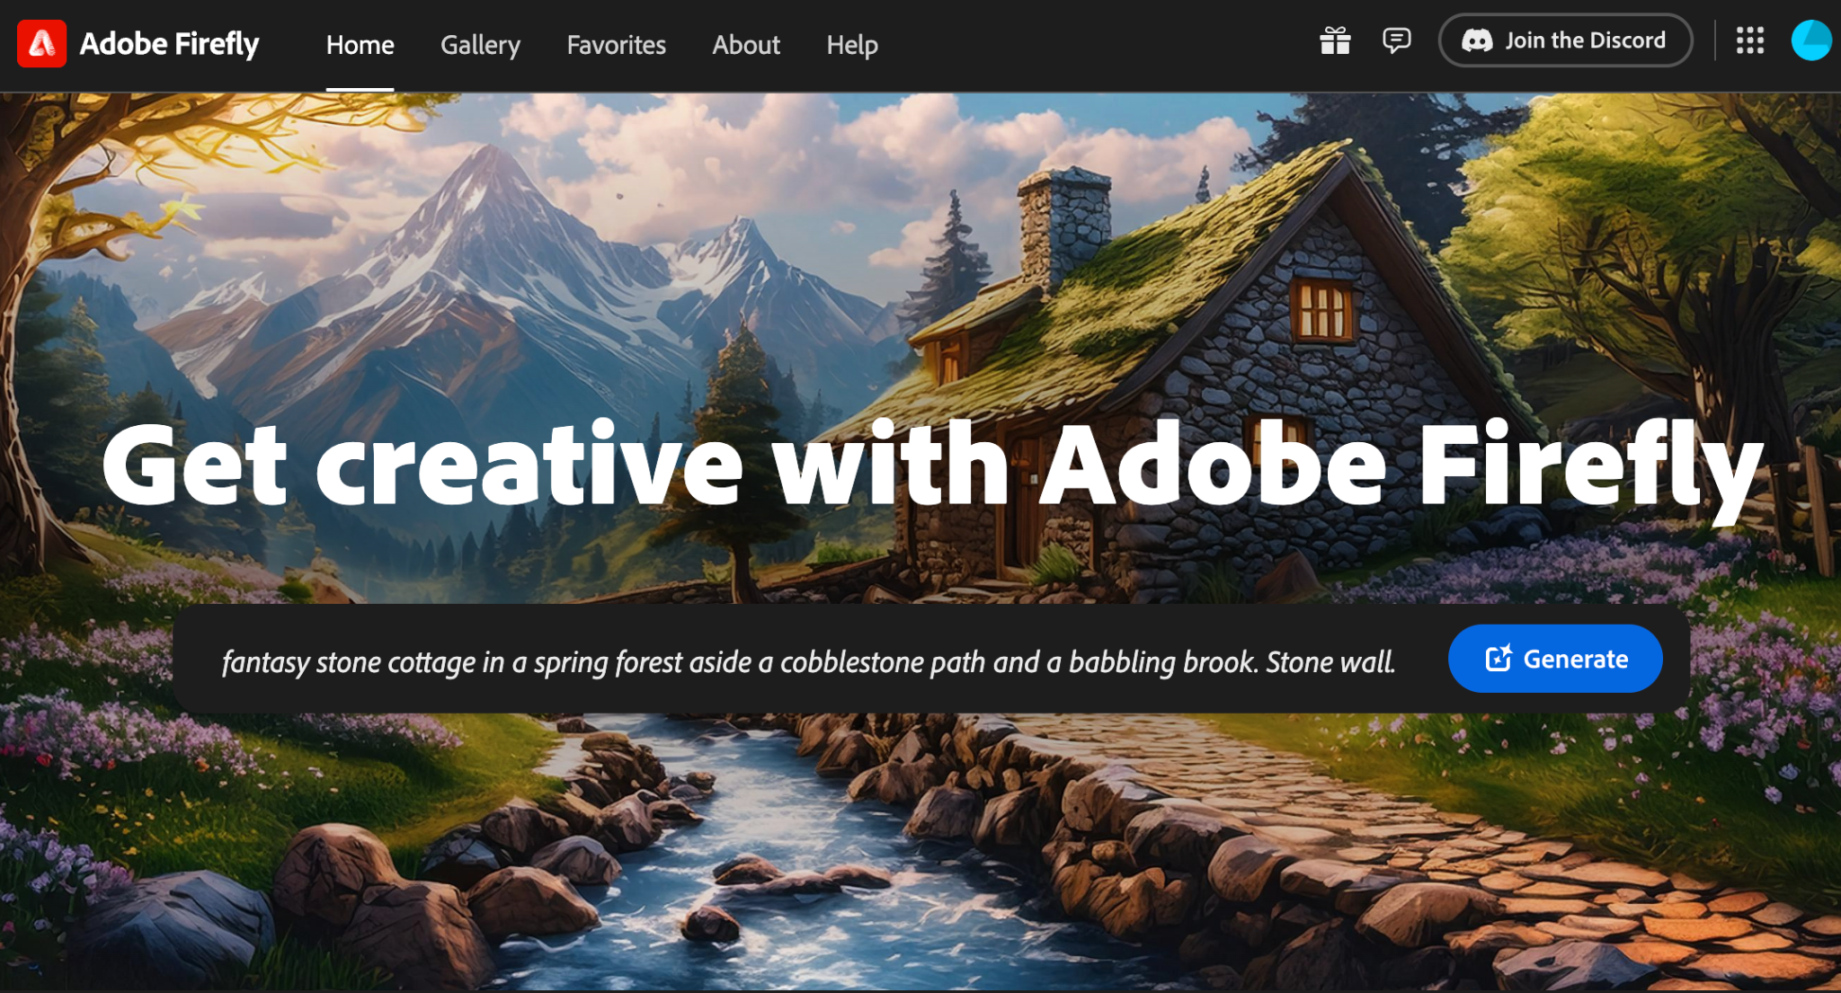
Adobe Firefly - Presented by Jeremiah Long

Slide 2
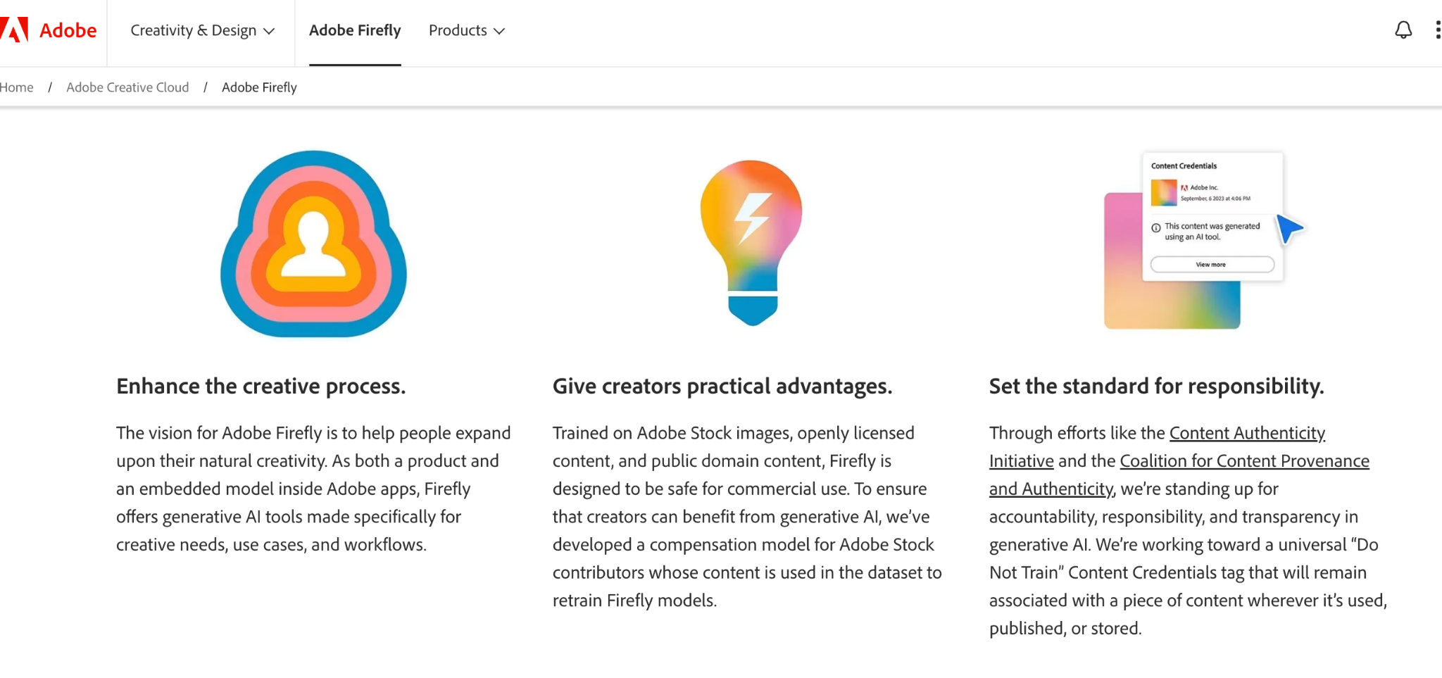
Adobe Firefly - Transparent AI Training Data

Slide 3
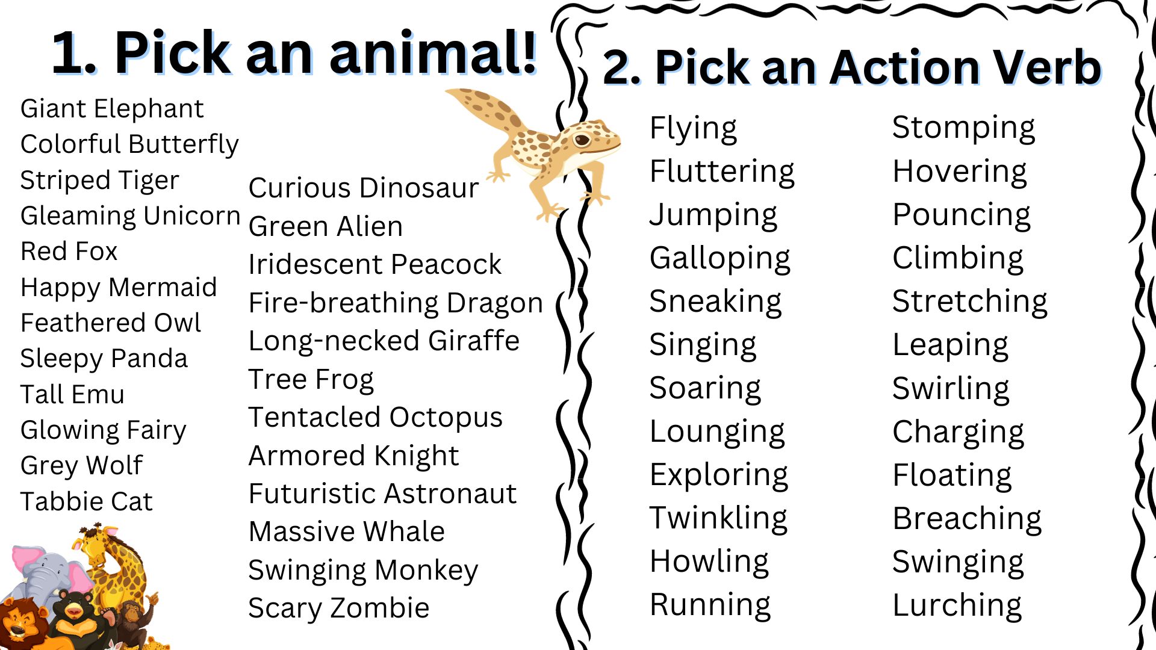

Slide 4
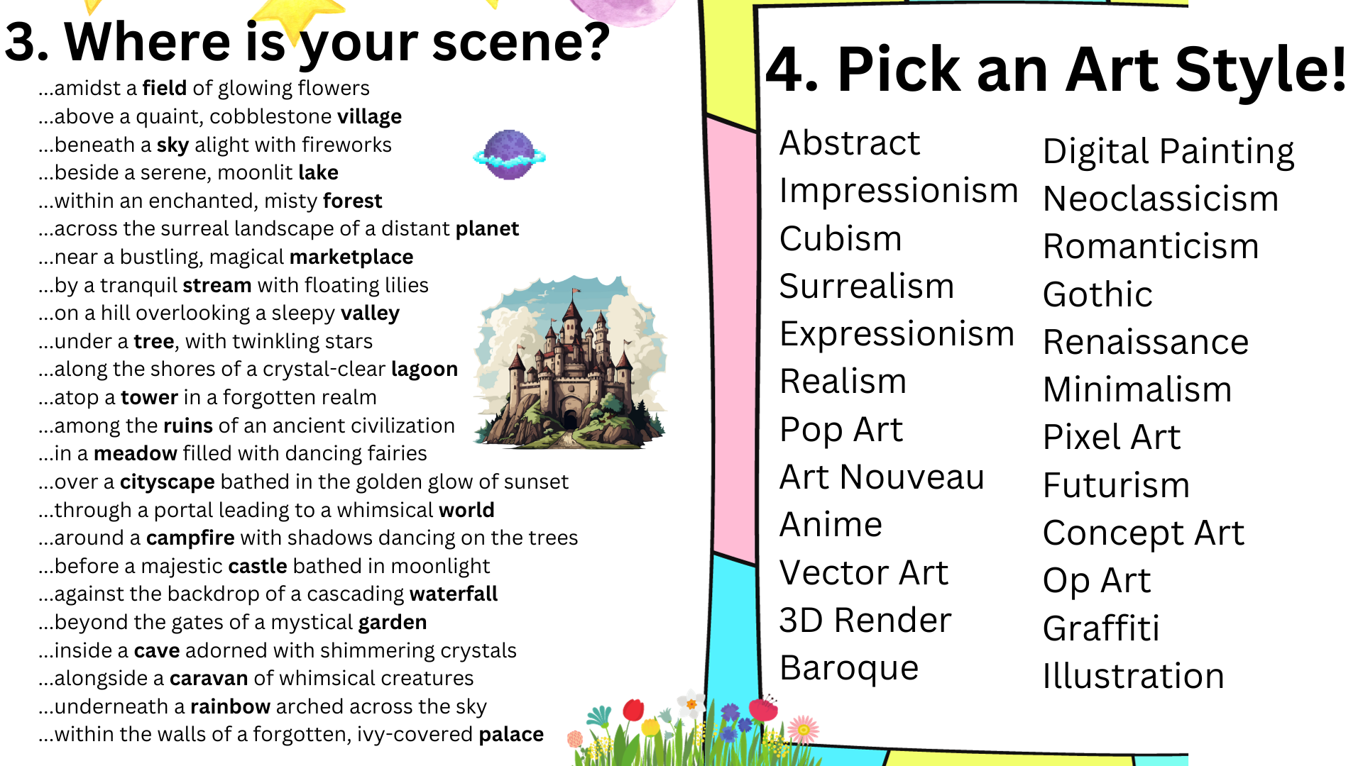

Slide 5

Atlanta Renaissance Art Project
Self guided practice:
Make 1-2 AI images on
your own using Adobe Firefly

