Slide 1
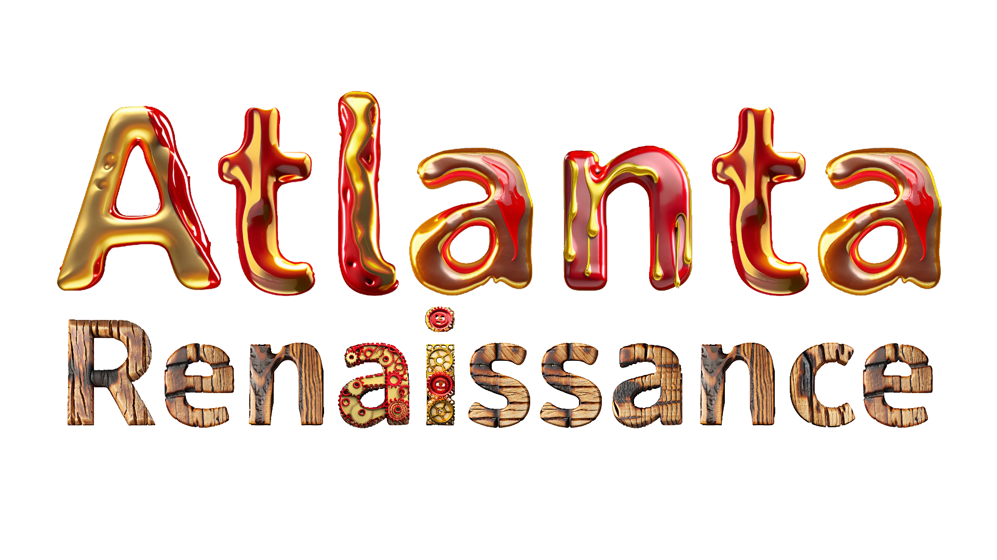


AI Art Tools Workshop | Virtual Session

Slide 2
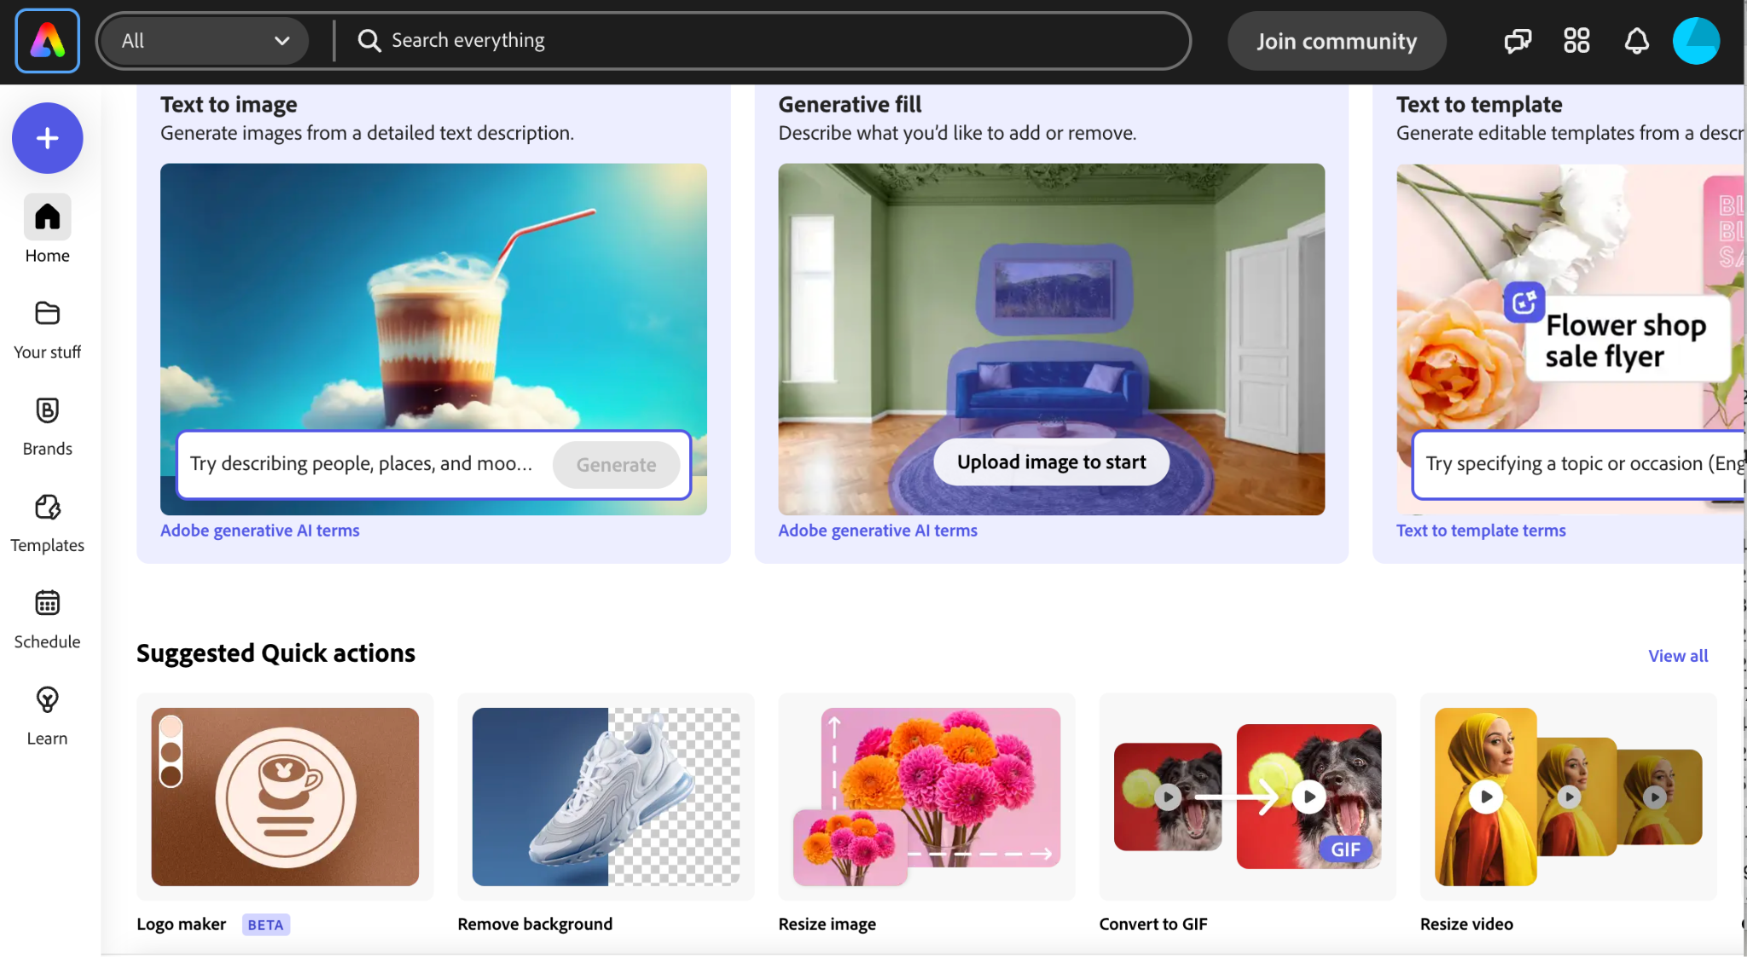
Adobe Express - Presented by Jeremiah Long

Slide 3
Adobe Express with Firefly Gen AI
Links to the Adobe Express Templates:
tinyurl.com/LHSgosteam

Slide 4
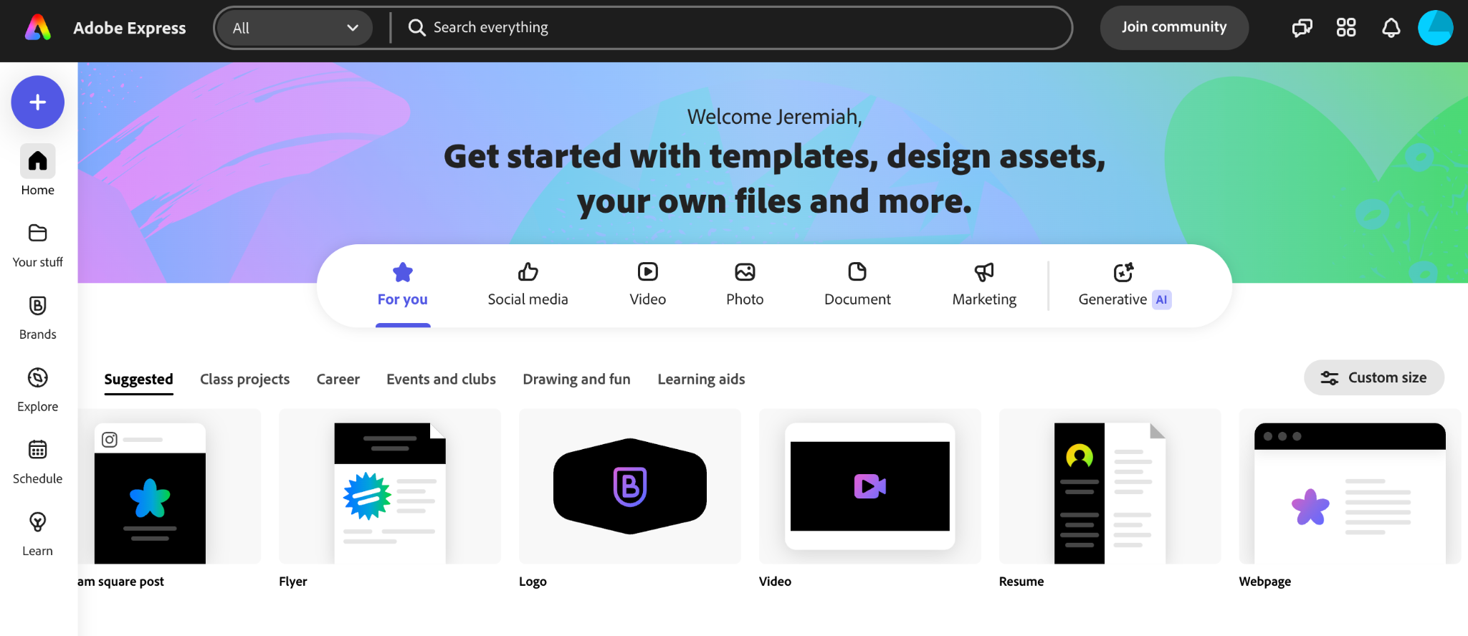
Adobe Express with Firefly AI

Slide 5
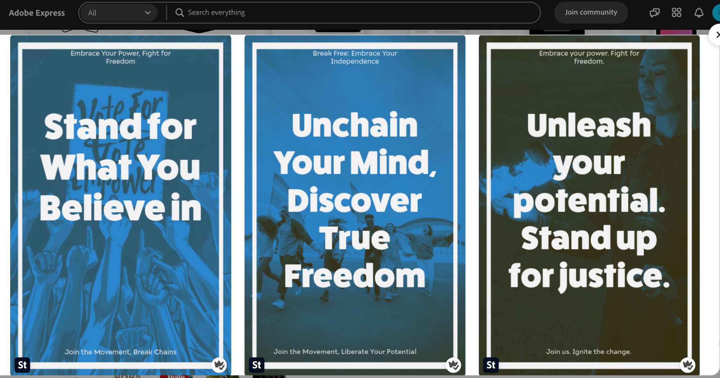
Adobe Express with Firefly AI

Slide 6
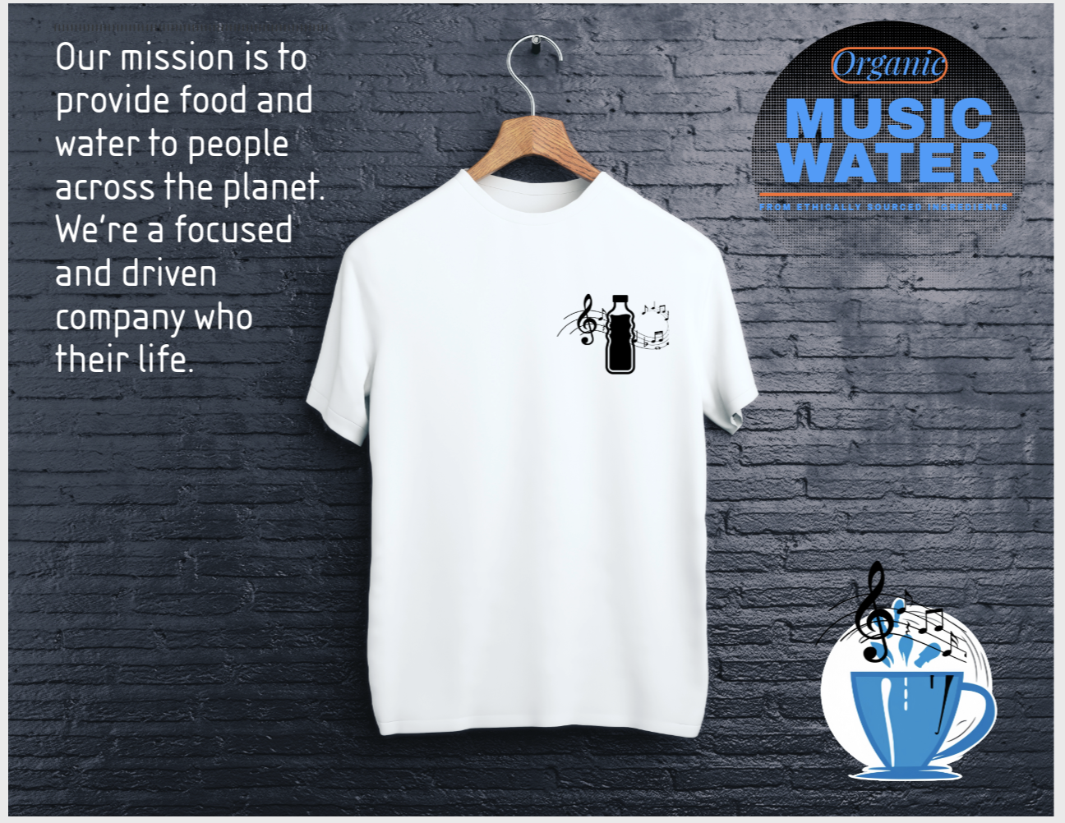
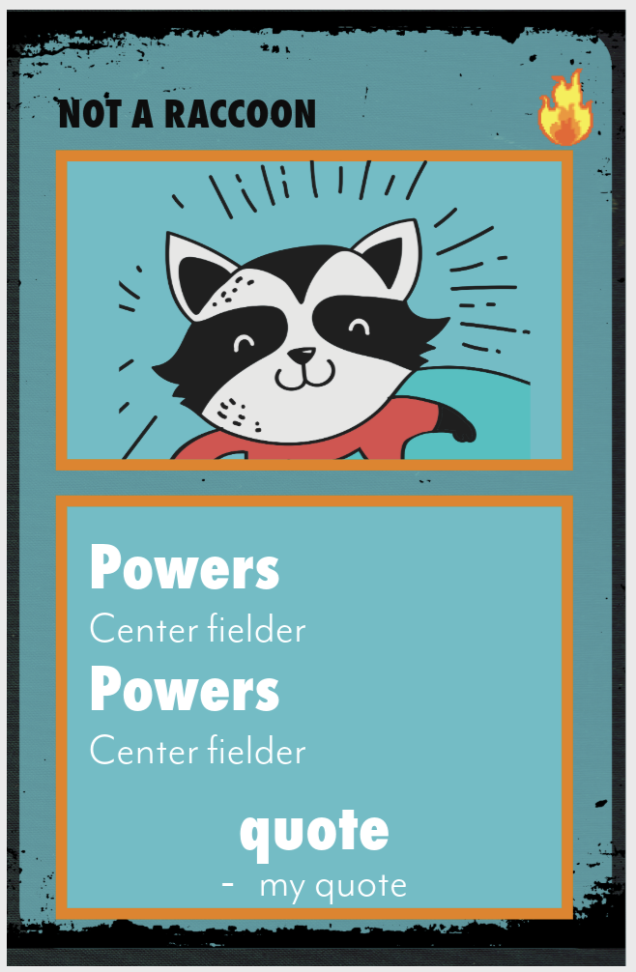
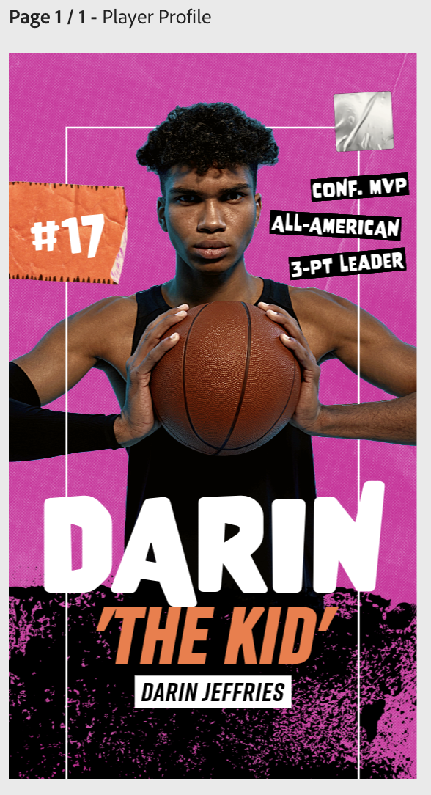
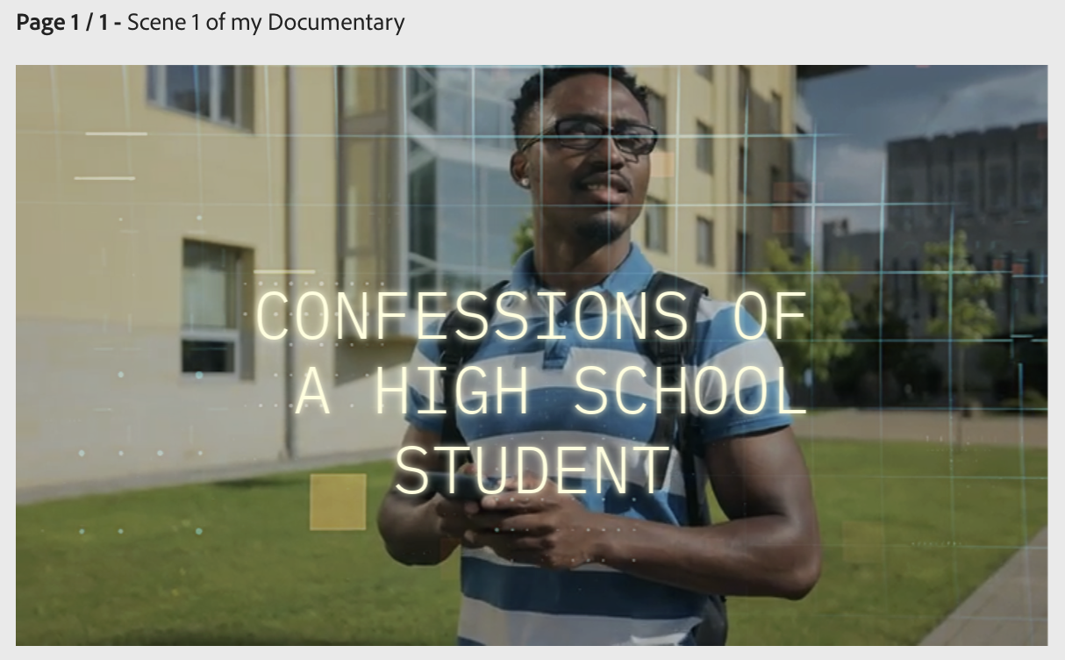
Adobe Express with Firefly AI

Slide 7
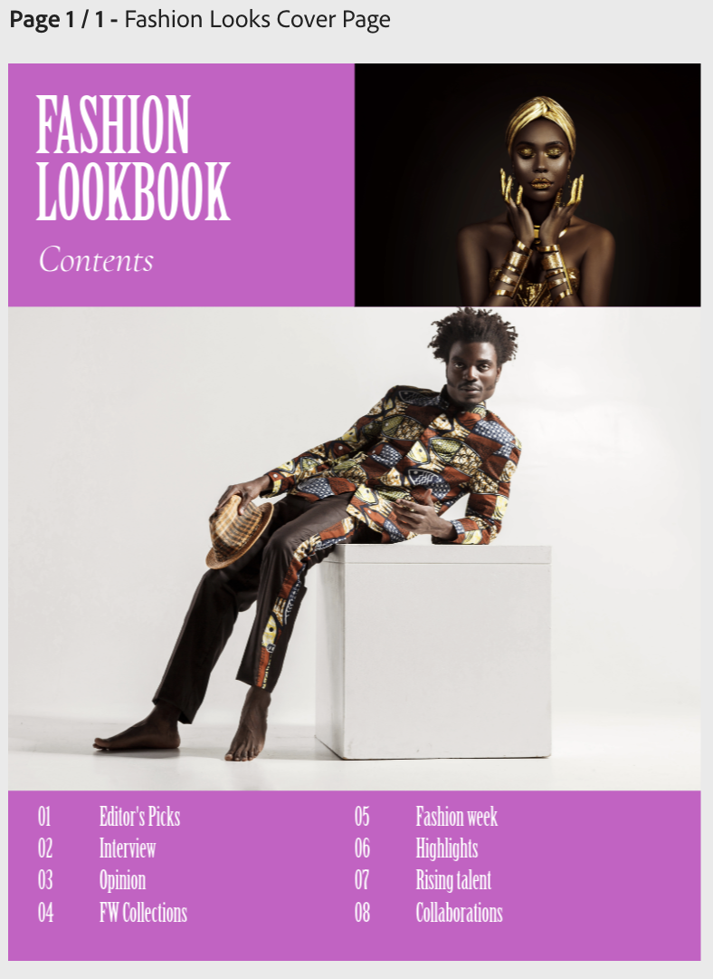
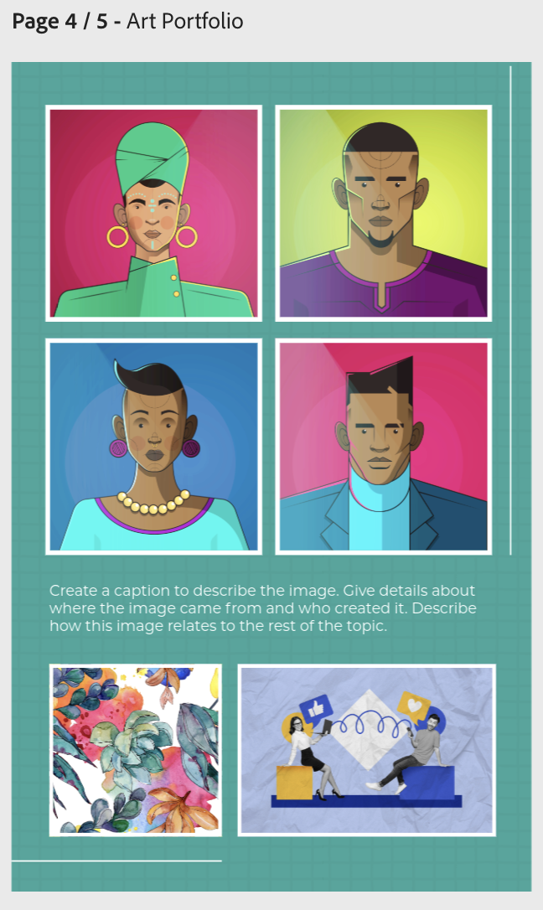

Adobe Express with Firefly AI

Slide 8
Adobe Express with Firefly AI
T-Shirt Company
https://new.express.adobe.com/published/urn:aaid:sc:US:76255340-918d-4871-902b-bf55f4f91e6e?promoid=Y69SGM5H&mv=other
Activist Poster
https://new.express.adobe.com/published/urn:aaid:sc:US:d2c9c5d4-daaa-4a9b-8397-227edb5c530b?promoid=Y69SGM5H&mv=other
Comic Book Cover
https://new.express.adobe.com/published/urn:aaid:sc:US:4822af7b-01ee-4543-aaac-ce27dc3f4dfb?promoid=Y69SGM5H&mv=other
Poetry
https://new.express.adobe.com/published/urn:aaid:sc:US:944b916d-a6bc-4cb7-8ef5-8230b9d02d18?promoid=Y69SGM5H&mv=other
Album Cover
https://new.express.adobe.com/explore/templates?q=album+cover
Fashion Lookbook
https://new.express.adobe.com/published/urn:aaid:sc:US:46faed9c-973a-442b-8af5-abf5e98c3b21?promoid=Y69SGM5H&mv=other
Art Portfolio
https://new.express.adobe.com/published/urn:aaid:sc:US:b6929de6-578c-4902-94f3-025b38287c20?promoid=Y69SGM5H&mv=other
Movie Poster
https://new.express.adobe.com/id/urn:aaid:sc:US:ca02a20e-fe09-5195-836a-39aed280d331?invite=true&promoid=Z2G1FQKR&mv=other
Player Profile
https://new.express.adobe.com/published/urn:aaid:sc:US:8386b1ea-da81-4c6b-9d4b-28a785c7e112?promoid=Y69SGM5H&mv=other
Song Lyrics
https://new.express.adobe.com/explore/templates?q=song+lyrics
Photography
https://new.express.adobe.com/explore/templates?q=photography
Short Film - Documentary
https://new.express.adobe.com/published/urn:aaid:sc:US:17bfa25d-3f67-4e3b-b1b8-8a28399d9e39?promoid=Y69SGM5H&mv=other
Trading Card
https://new.express.adobe.com/published/urn:aaid:sc:US:dc60803d-117f-4fa9-b93e-72fc7db810f8?promoid=Y69SGM5H&mv=other

Slide 9
Periodic Table CCG - Presented by Jeremiah Long
Let’s use our AI Art and Gfx Design skills!
In this project we will use:
Adobe Firefly to create a character image
Adobe Express to layout our collectible card game
Additional project ideas and template links

