Slide 1
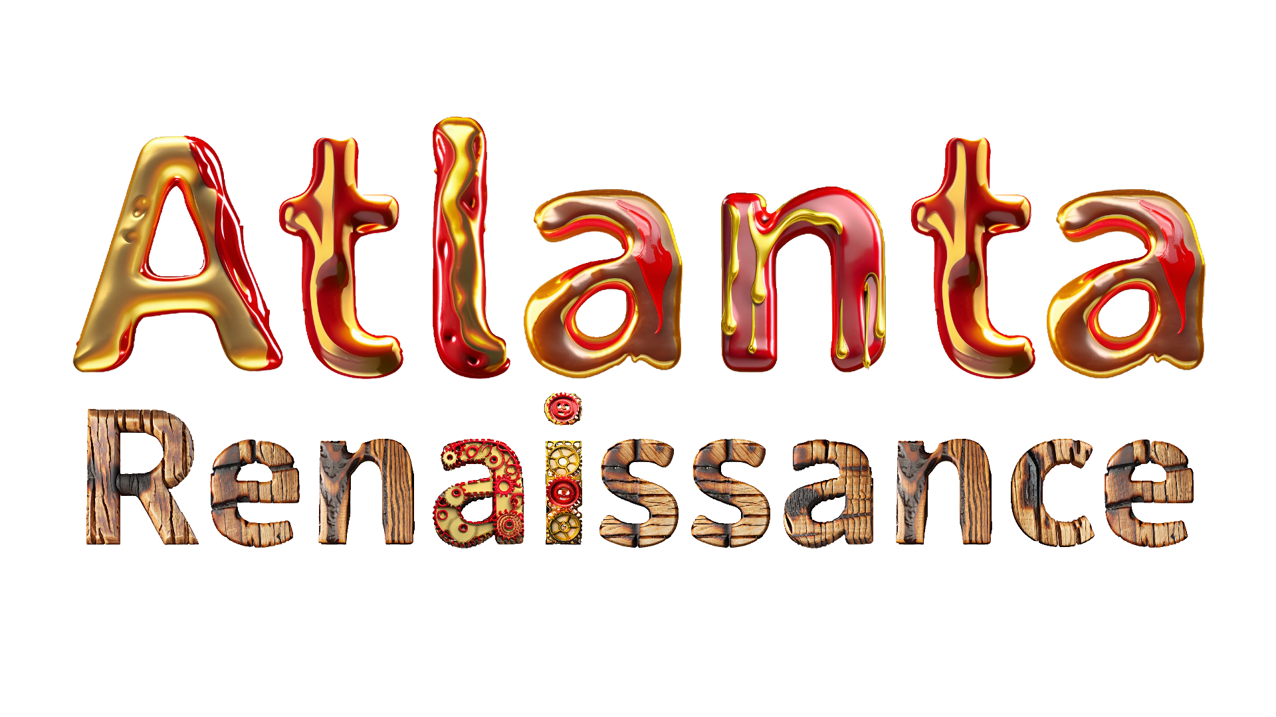

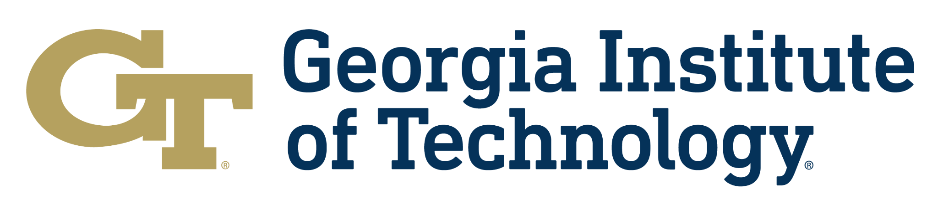
AI Art Tools Workshop | Virtual Session

Slide 2
AI Art Tools for Image, Video, Audio
Adobe Firefly Suite (Firefly, Photoshop, Illustrator, Premier, etc)
Midjourney - Use through Discord or midjourney.com/app
DALL-E / Sora - OpenAI’s text-to-image/video models
AI For Kids App - JL’s accessible AI Art app www.aiforkids.app
Stable Diffusion - Mostly open source image, audio, video
Runway ML - Image, text-to-video, lipsync, editing, custom LoRA training
Meshy AI - text to 3D model tools for animation
Scenario AI - Game design assets, 3D models, custom LoRA training
Comfy UI - Highly technical image generation software, open source
Pika Labs - Advanced text-to-video models, camera control
Luma Labs - Gaussian Splat, volumetric capture, 3D, AI video
Many, many, others…

Slide 3
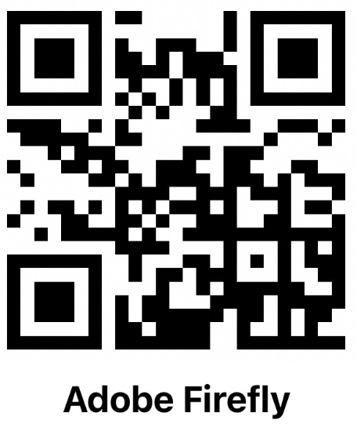
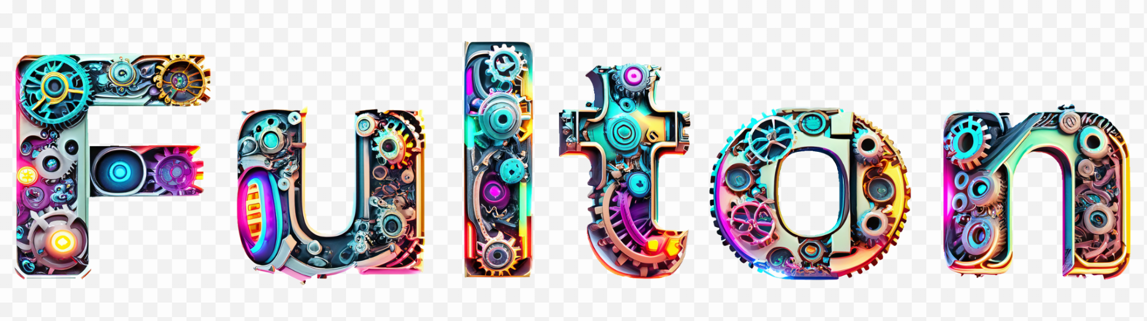
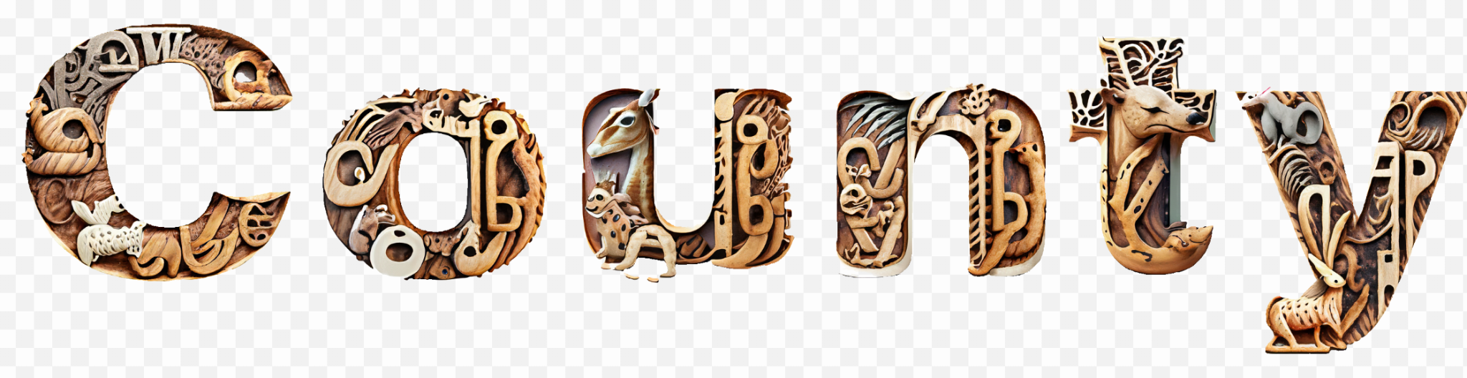
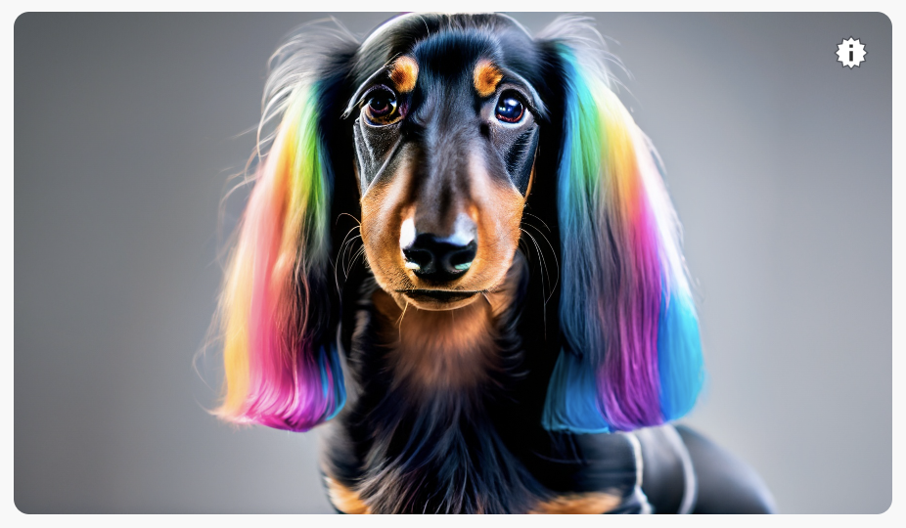
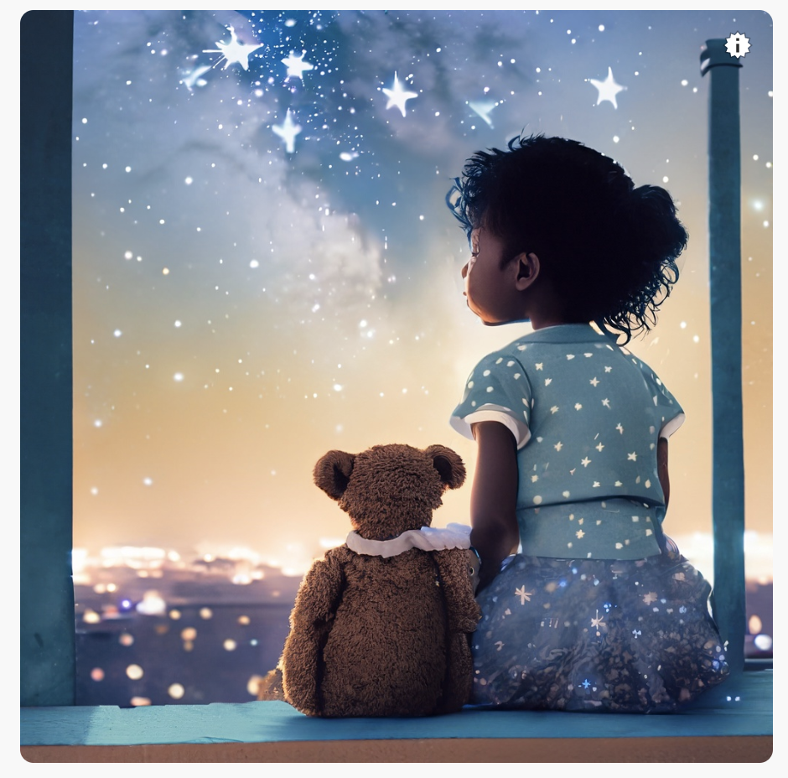
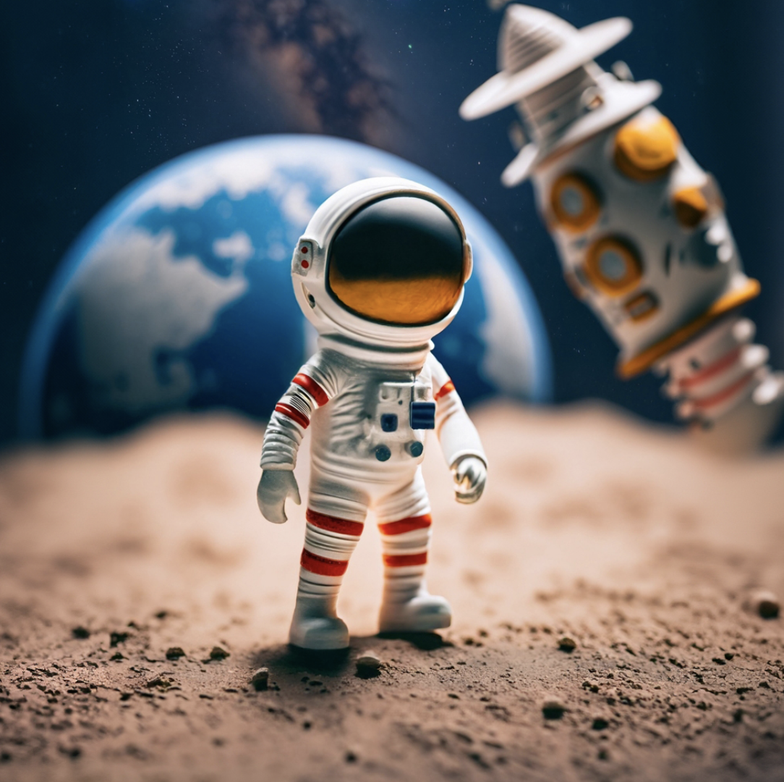
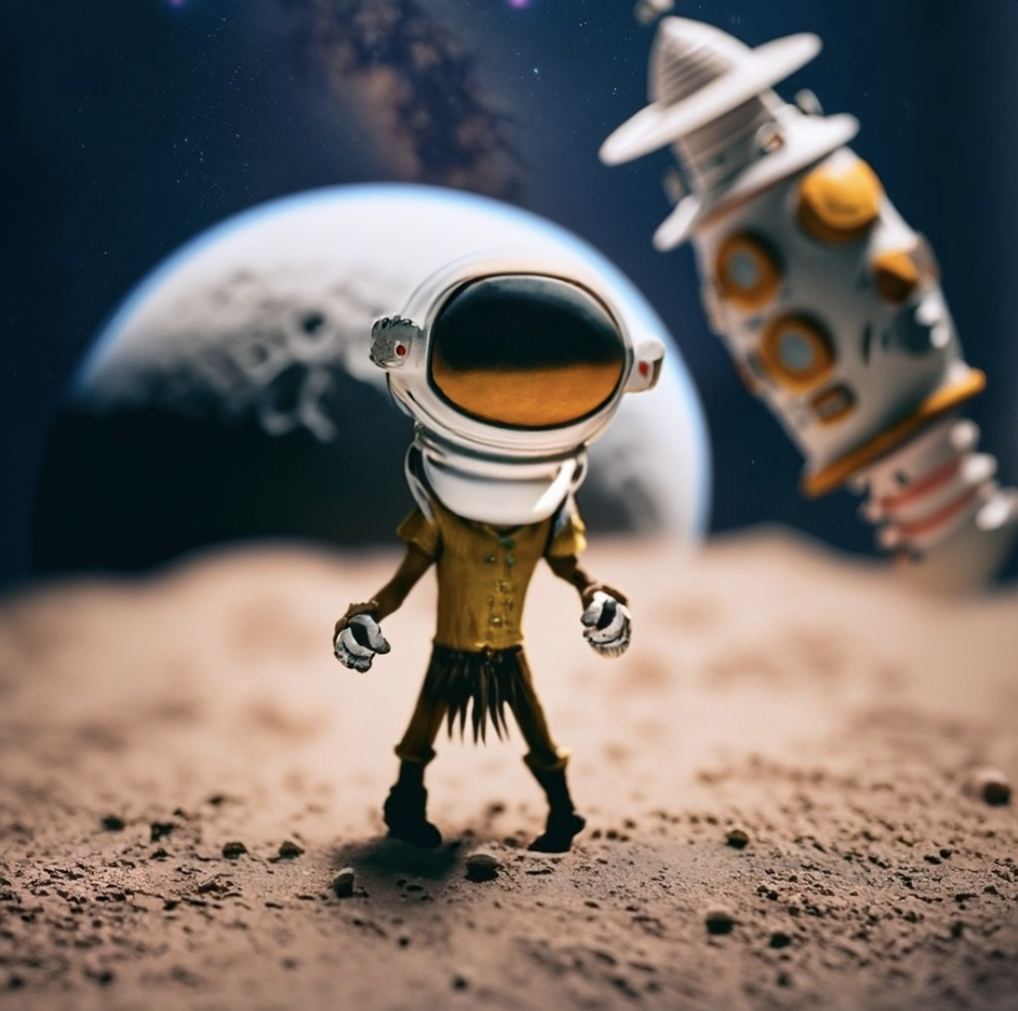
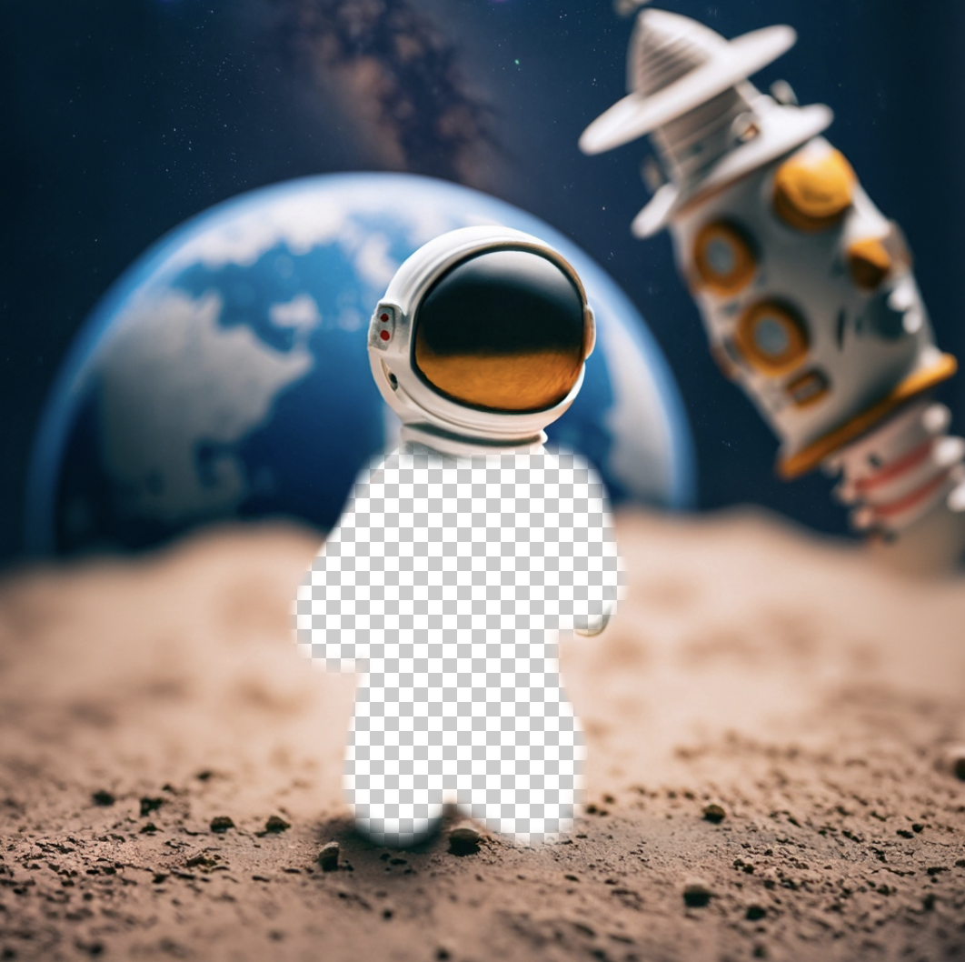
Adobe Firefly
AI Art: Create art, fonts and more. Adobe only trains their AI on Adobe’s Stock library, public domain, and licenced images.

Slide 4
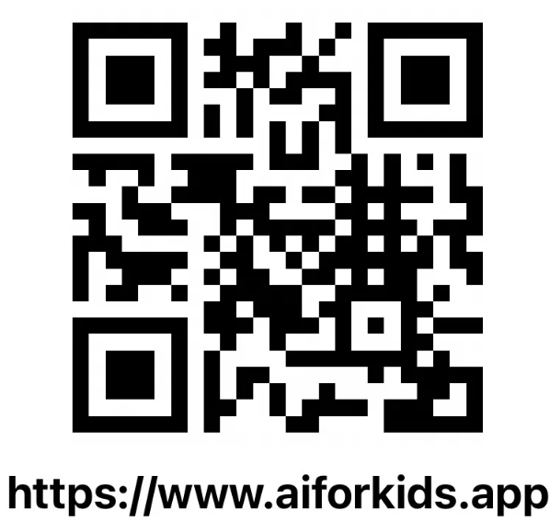
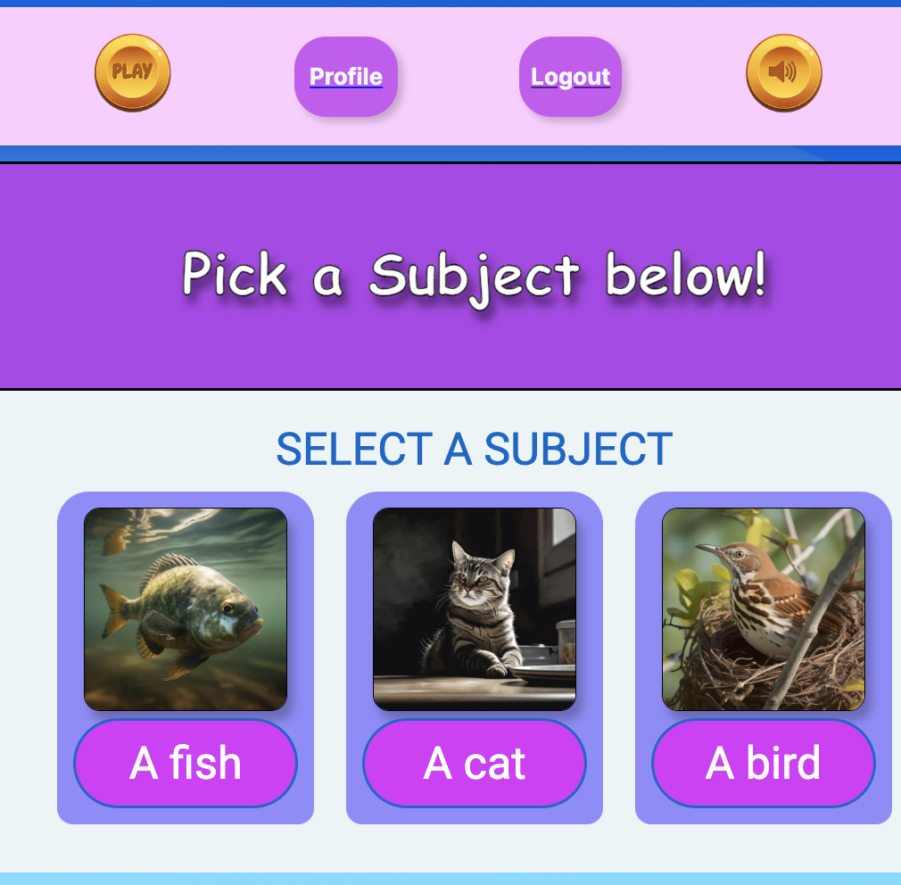
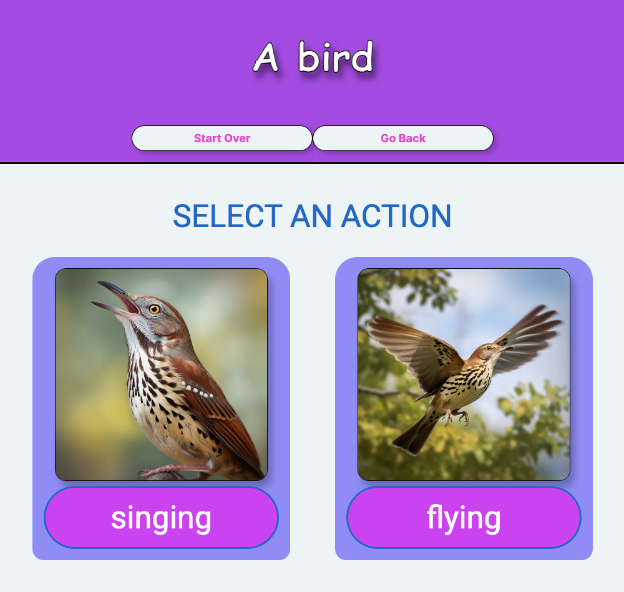
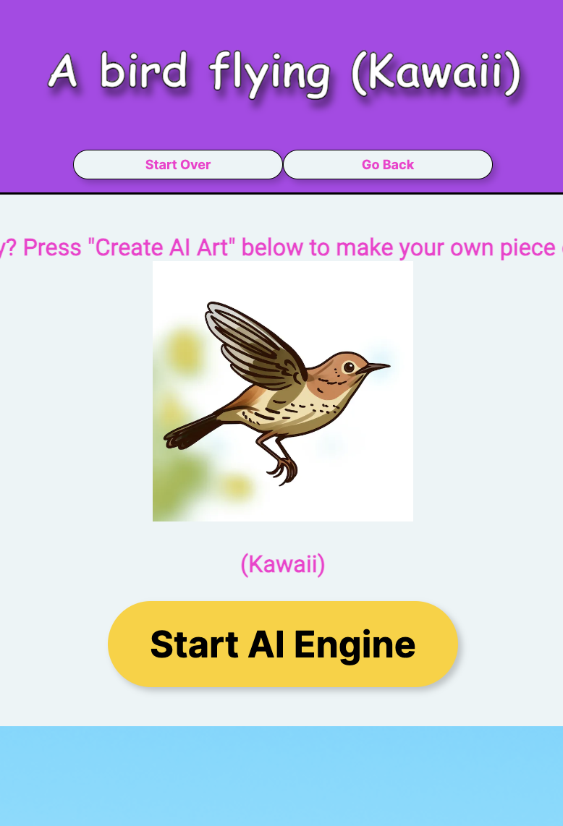
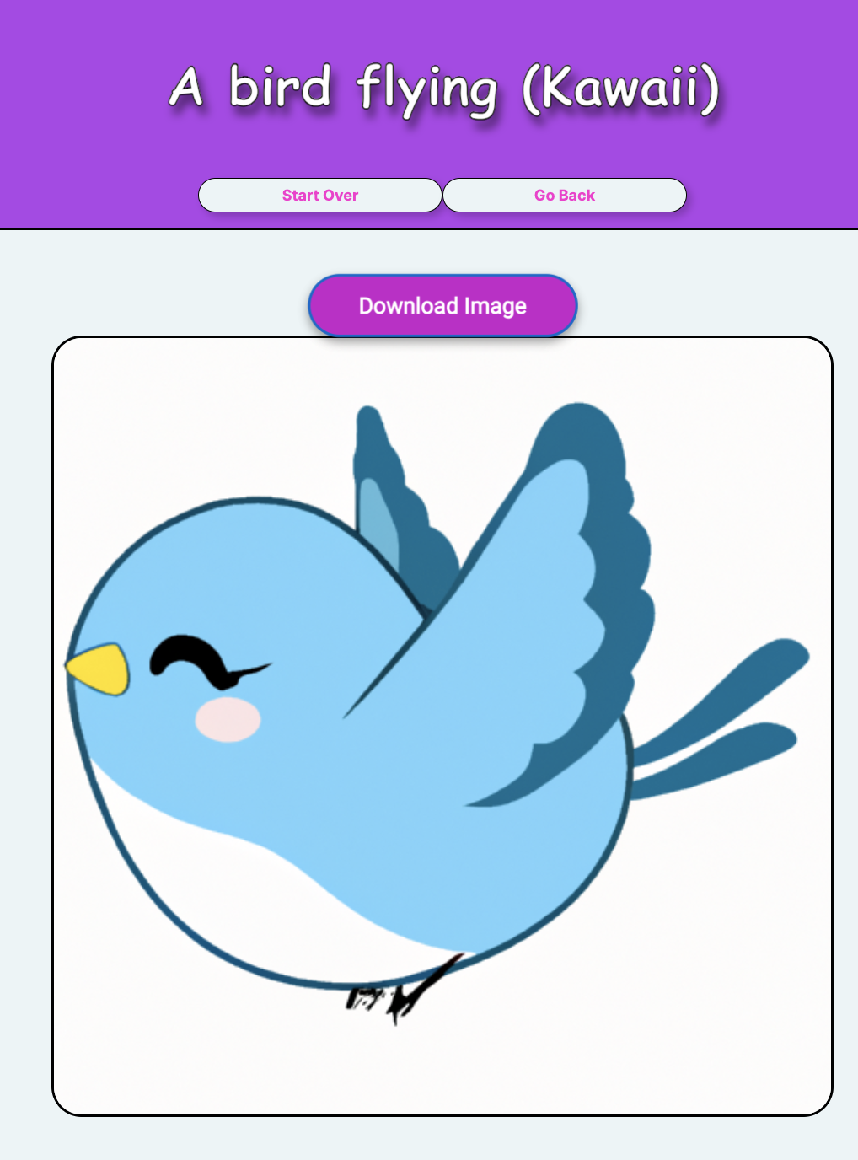
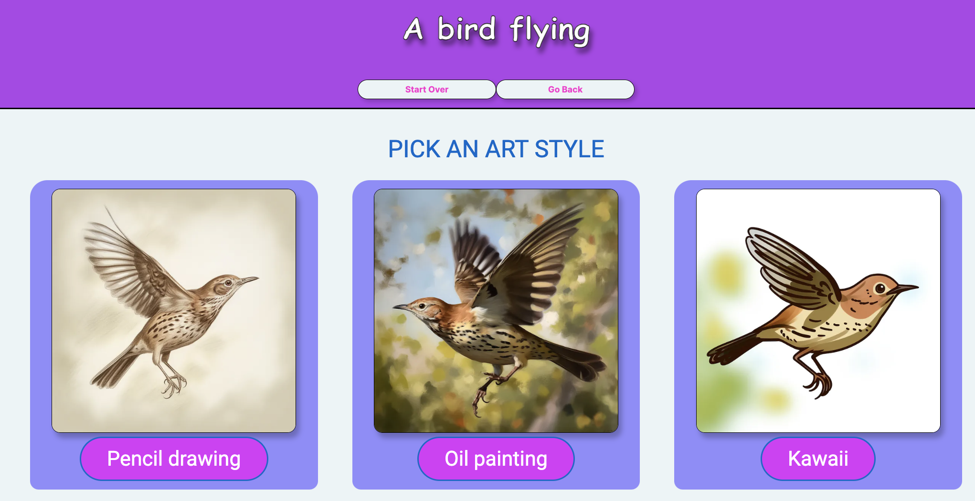
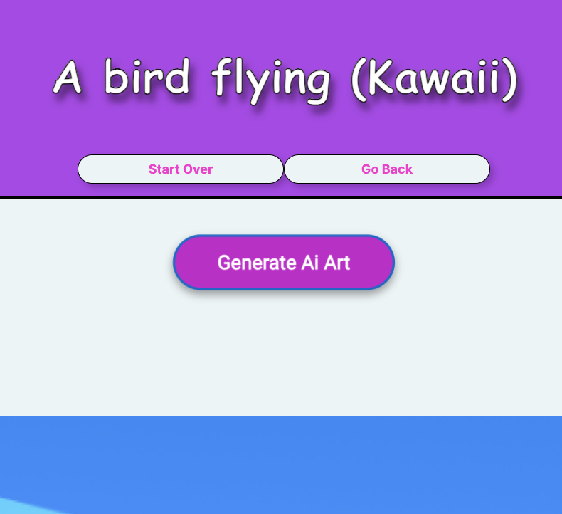
AiForKids.app
Safe AI Art creation for kids, accessible if you can’t type easily

Slide 5
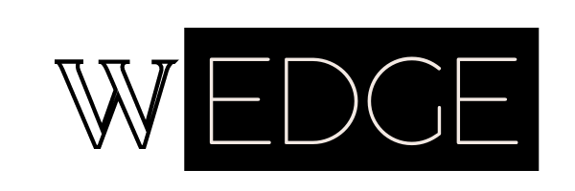
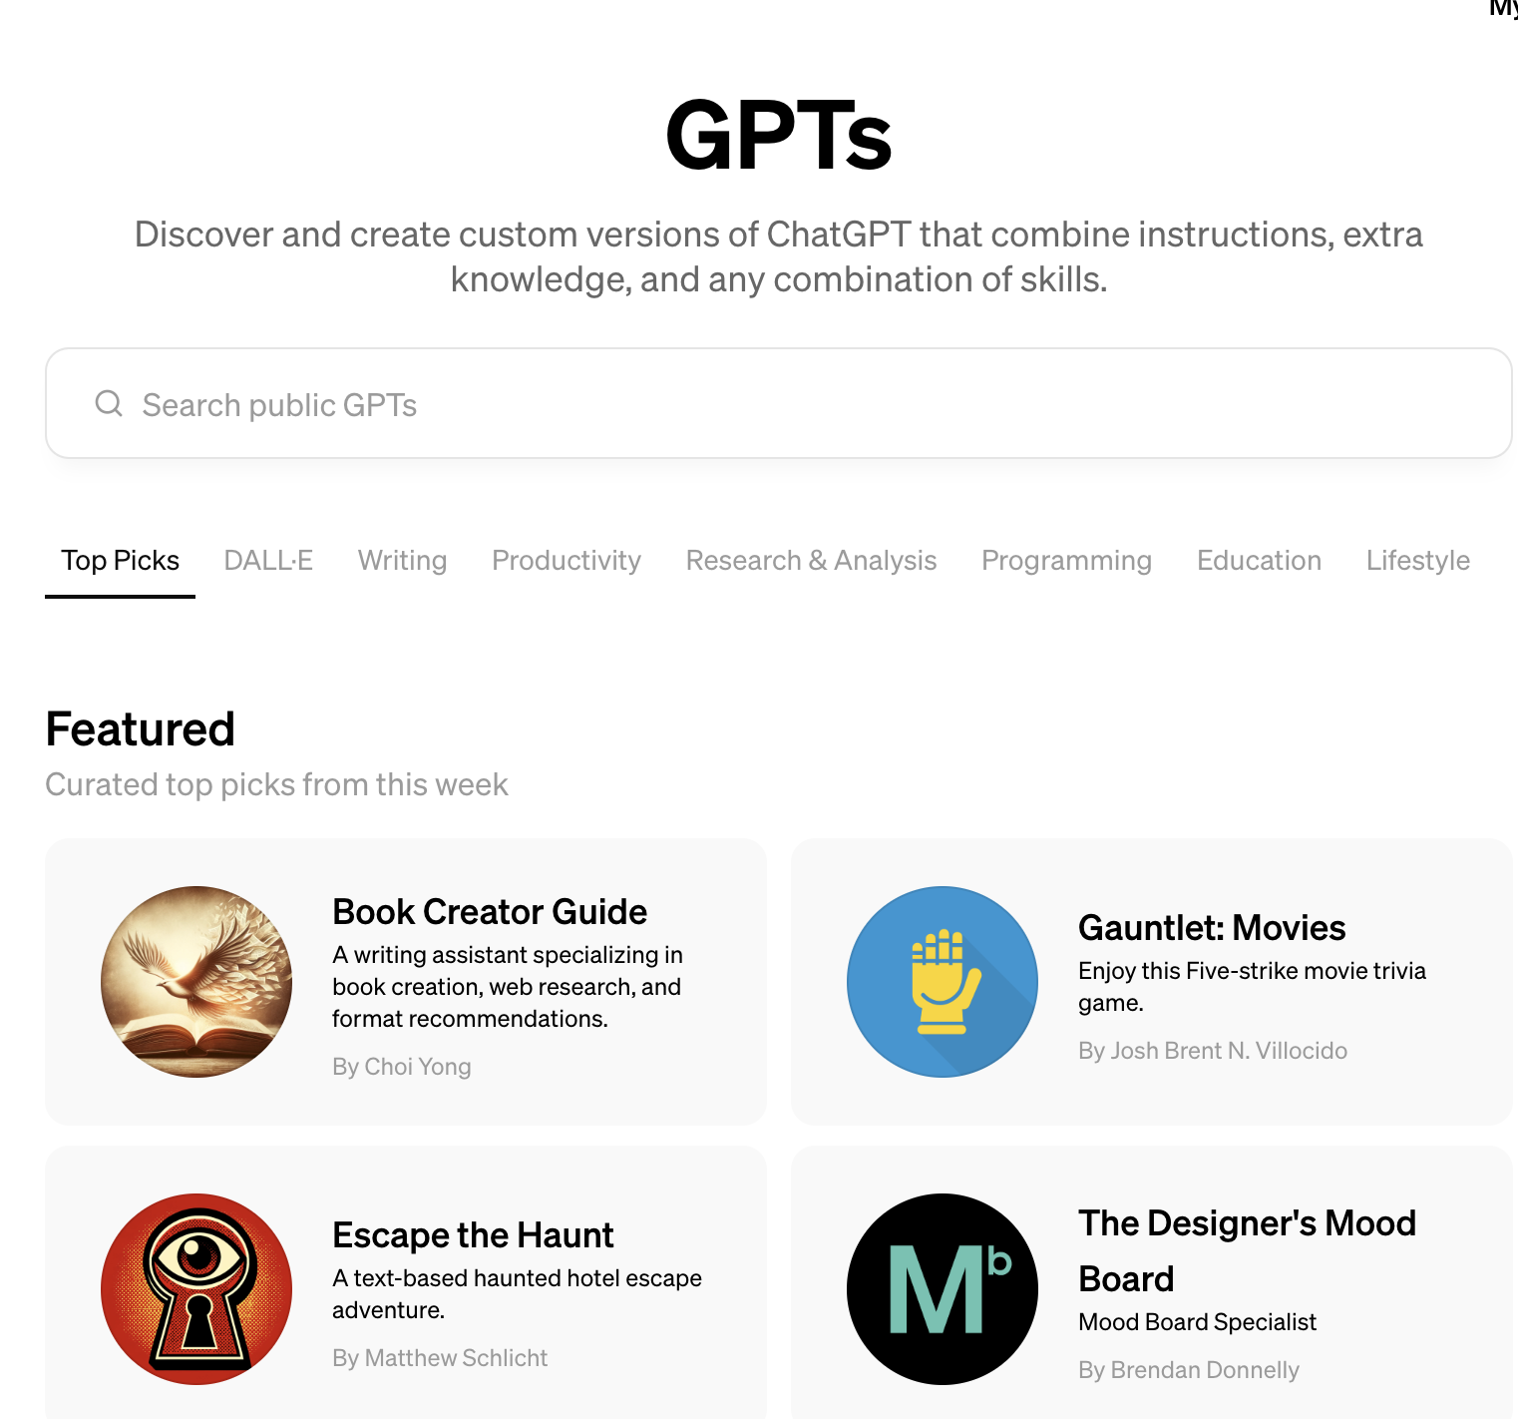
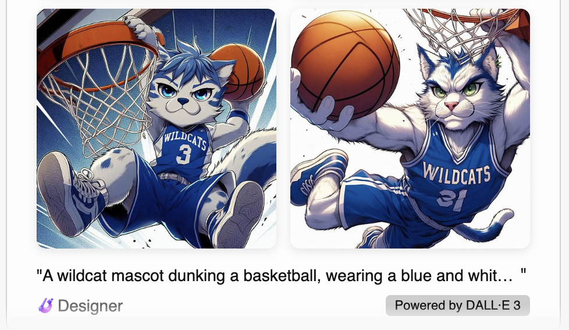
Words and Text - Copilot / Chat GPT 4
Microsoft Copilot aka Bing
Copilot works using Chat GPT 3.5 and 4. You can create AI Art images, write words, and craft creative projects.
OpenAI Chat GPT 3.5 and 4
The tool that started the consumer revolution in Generative AI. You can ask questions, get mostly good answers, use plugins to do just about anything, and create high res images using Dall-E 3’s AI Art generator.

Slide 6
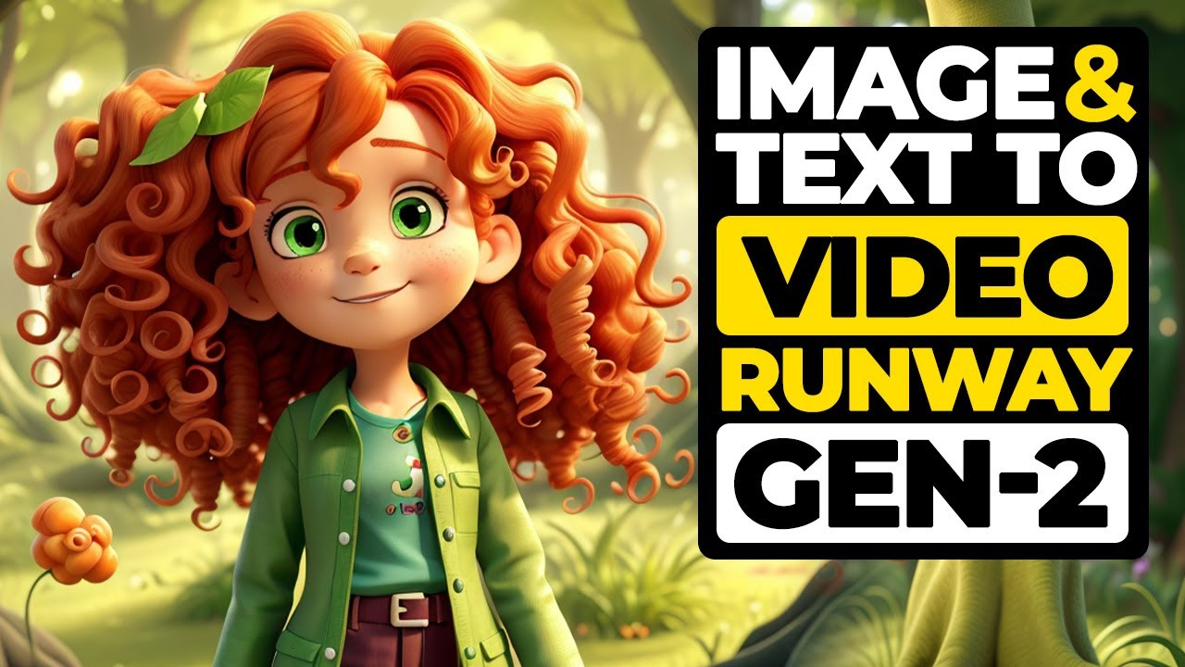
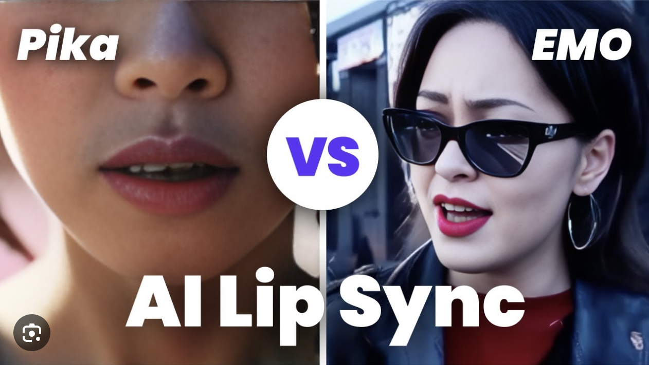
Text-to-Video - RunwayML / Pika Labs
Runway ML text-to-video
Advanced text-to-video AI. You can also use your own images or video as a starting place with Gen-1 and Gen-2. Runway also has a suite of Stable Diffusion based AI Art and video editing tools.
Pika Labs
The first text-to-video AI that allows for lip sync with your AI Art creations. Still early, but very advanced!

Slide 7
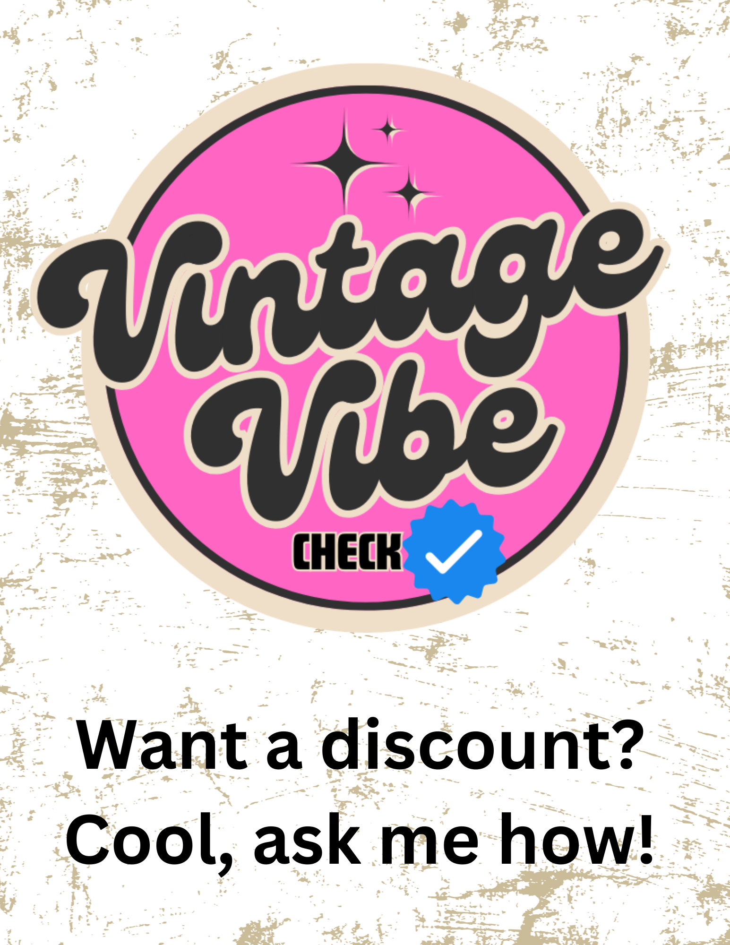
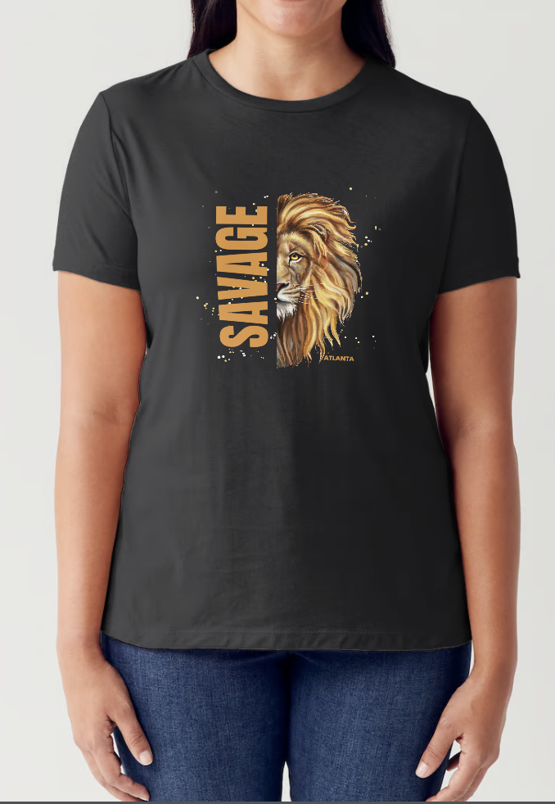
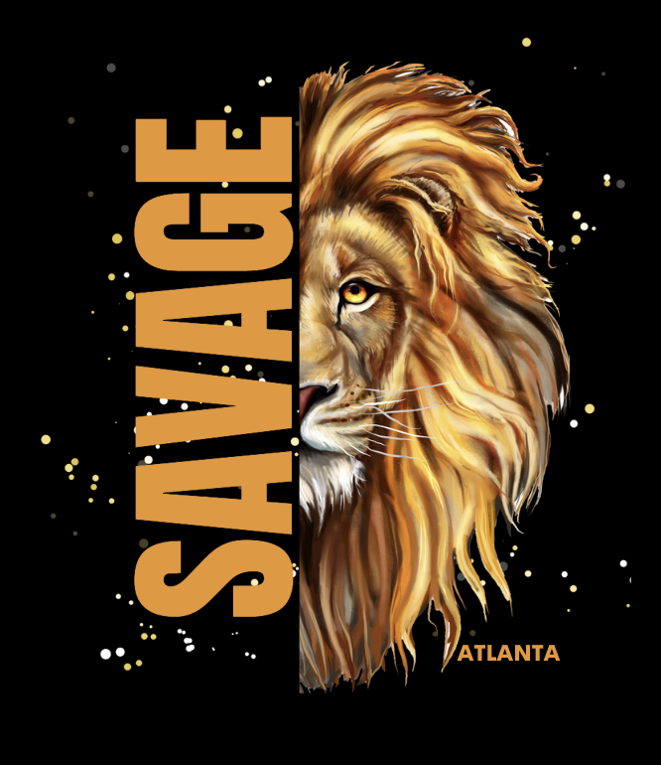
Graphic Design - Canva Magic Studio AI
Canva Magic Studio
Advanced graphic design, and layout. AI Art, AI writing, AI slide decks, and much more to come!
T-Shirt Design
Create a logo or design for a t-shirt. Create an entire fashion line just from your own art.
Brand Design
Design your brand, fashion line, or team. Create for picking colors and building your look and feel.

Slide 8
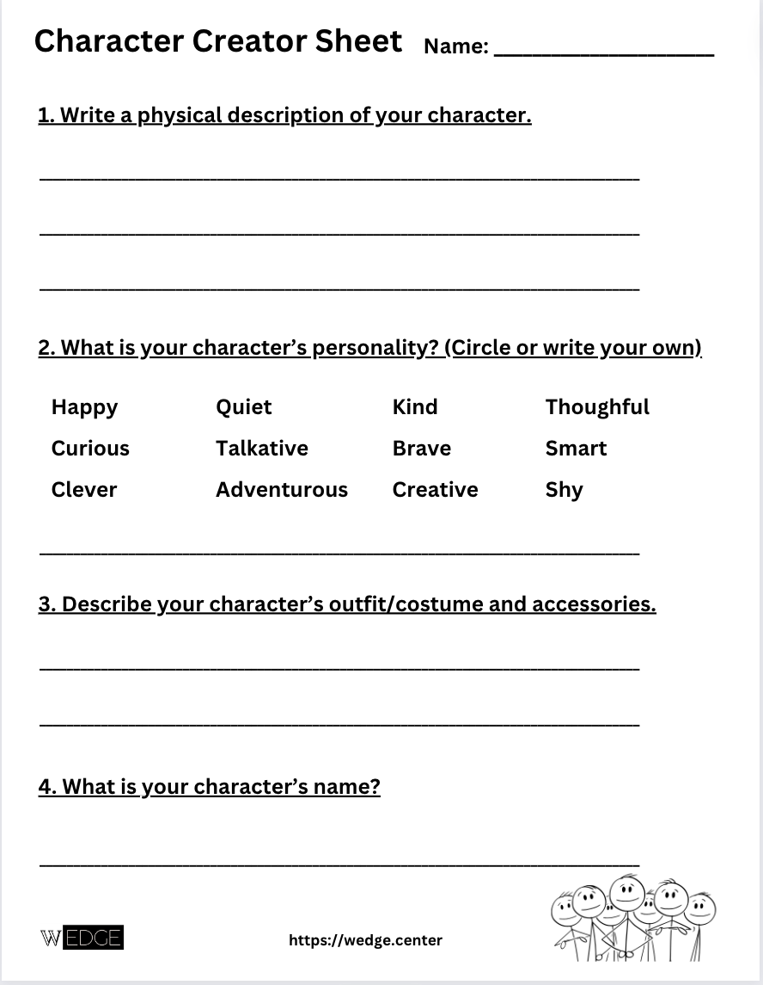
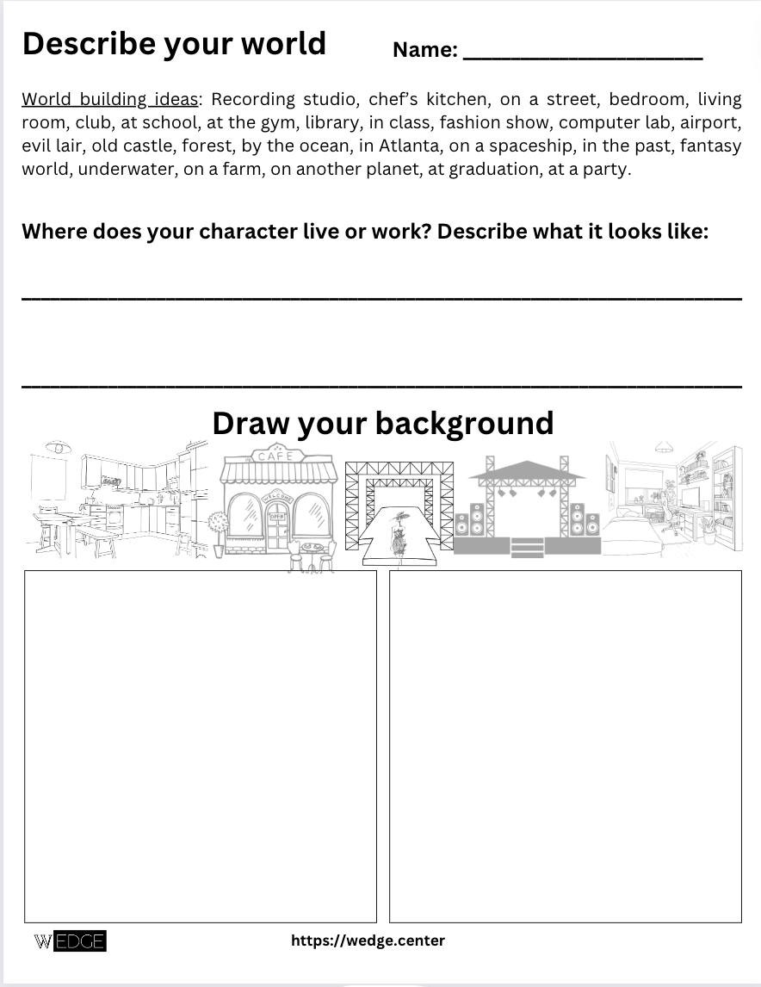
Bonus: Character Design Exercise

